Slide 1
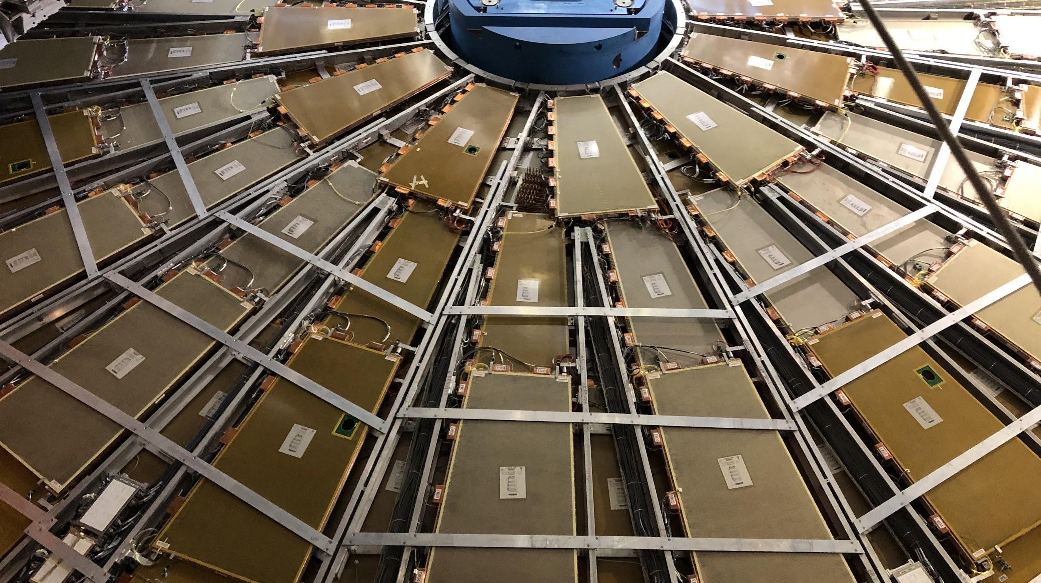


CIS Tech Update
Chicago Weekly Meeting, March 07 2022
Dawit Belayneh and Katie Hughes

Slide 2
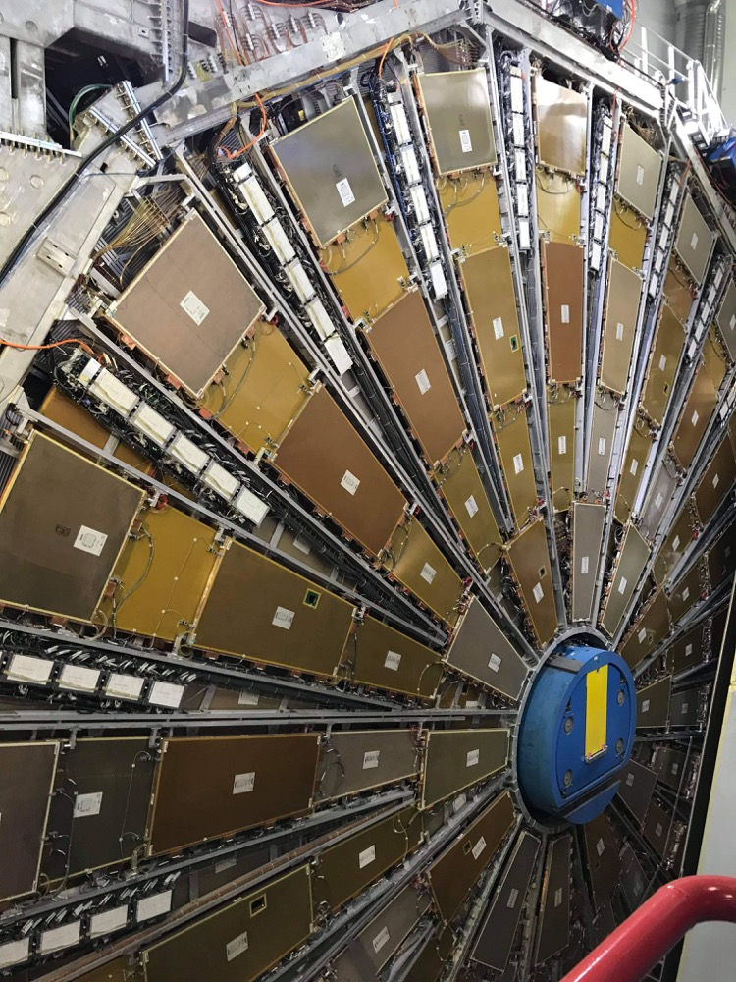
Outline
Cooling System + Leaks
CIS
Sim Work

Slide 3
Cooling System + Leaks

Slide 4
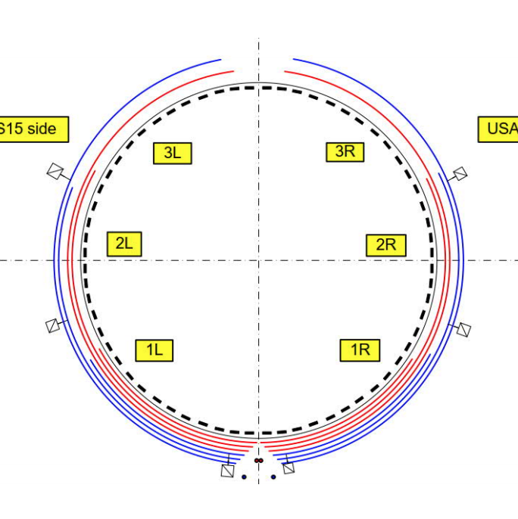
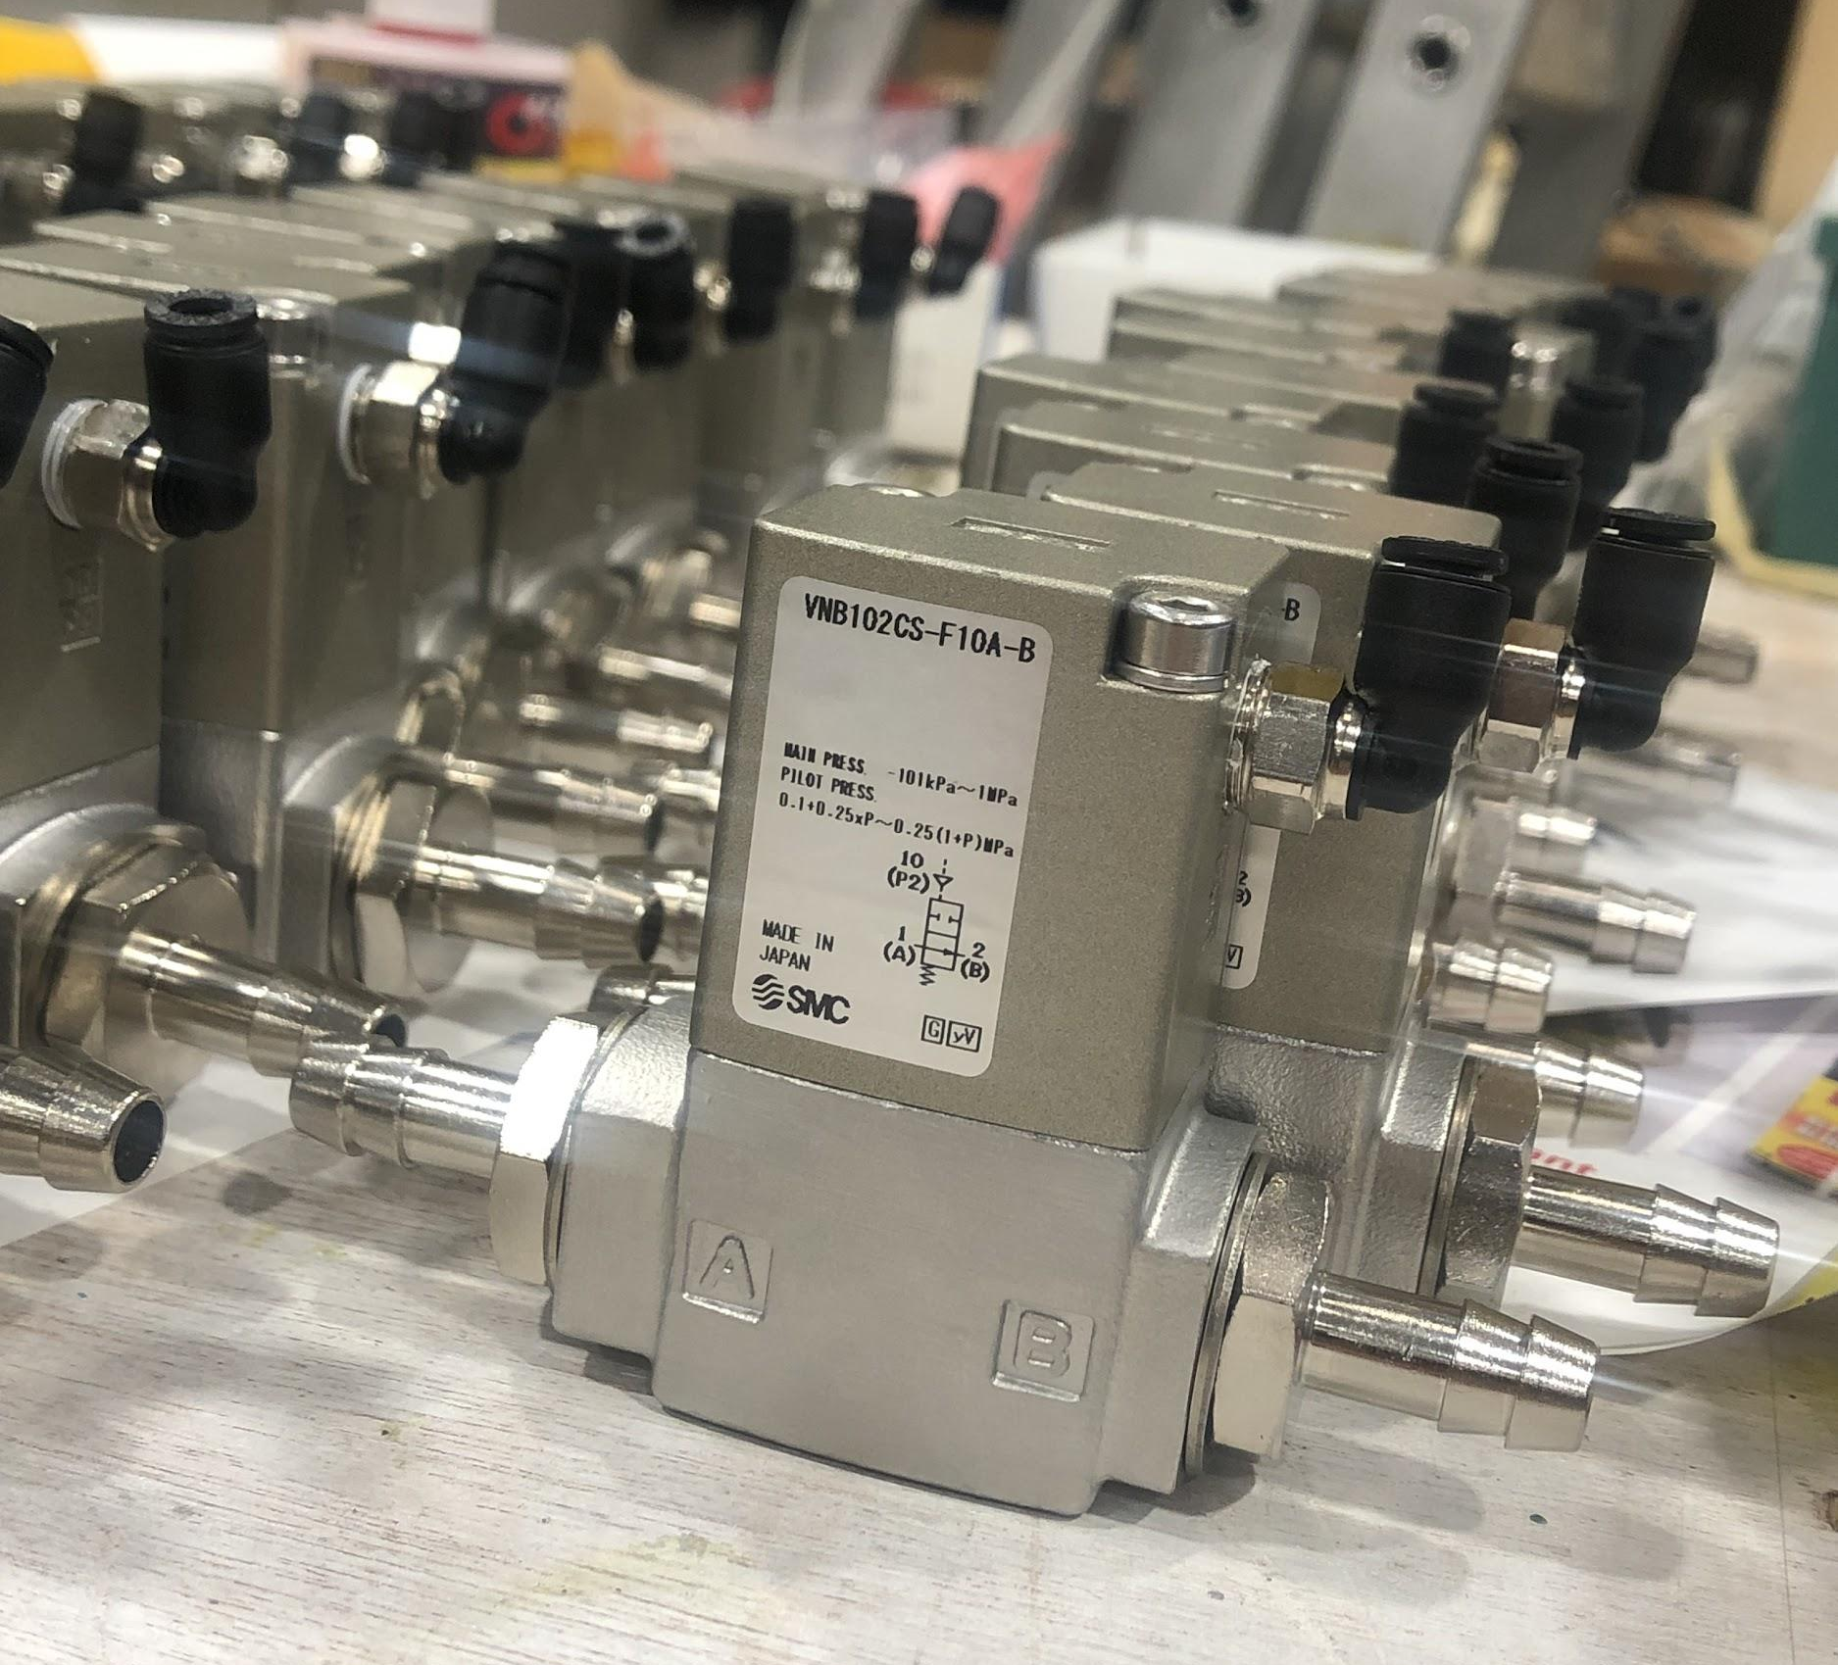
Motivation
Currently, a single cooling loop passes through 8-12 drawers
6 loops per partition
A leak in one drawer means all other drawers in the loop must be shut down to fix it – valves isolate leaks to a single drawer
We + past CIS techs have installed 512 valves on all Tilecal modules :)
Cooling Loop Distribution
Valves

Slide 5
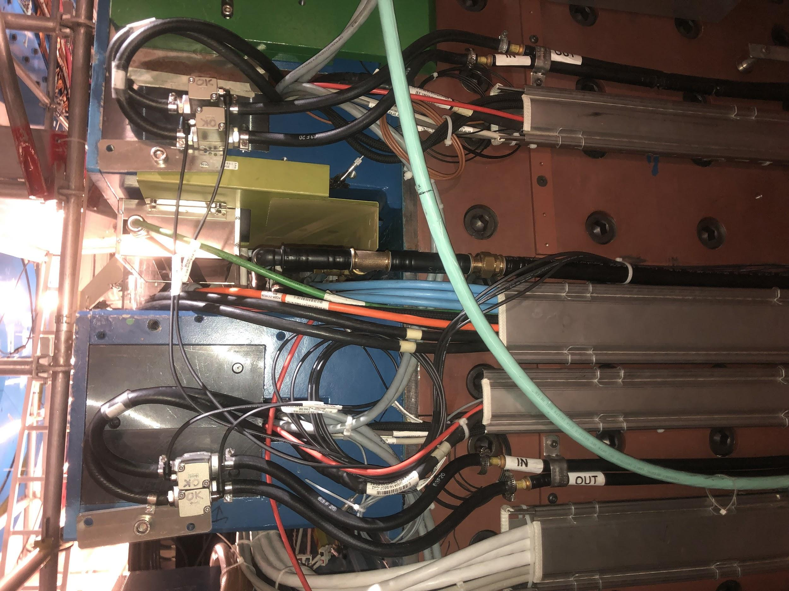
Examples

Slide 6
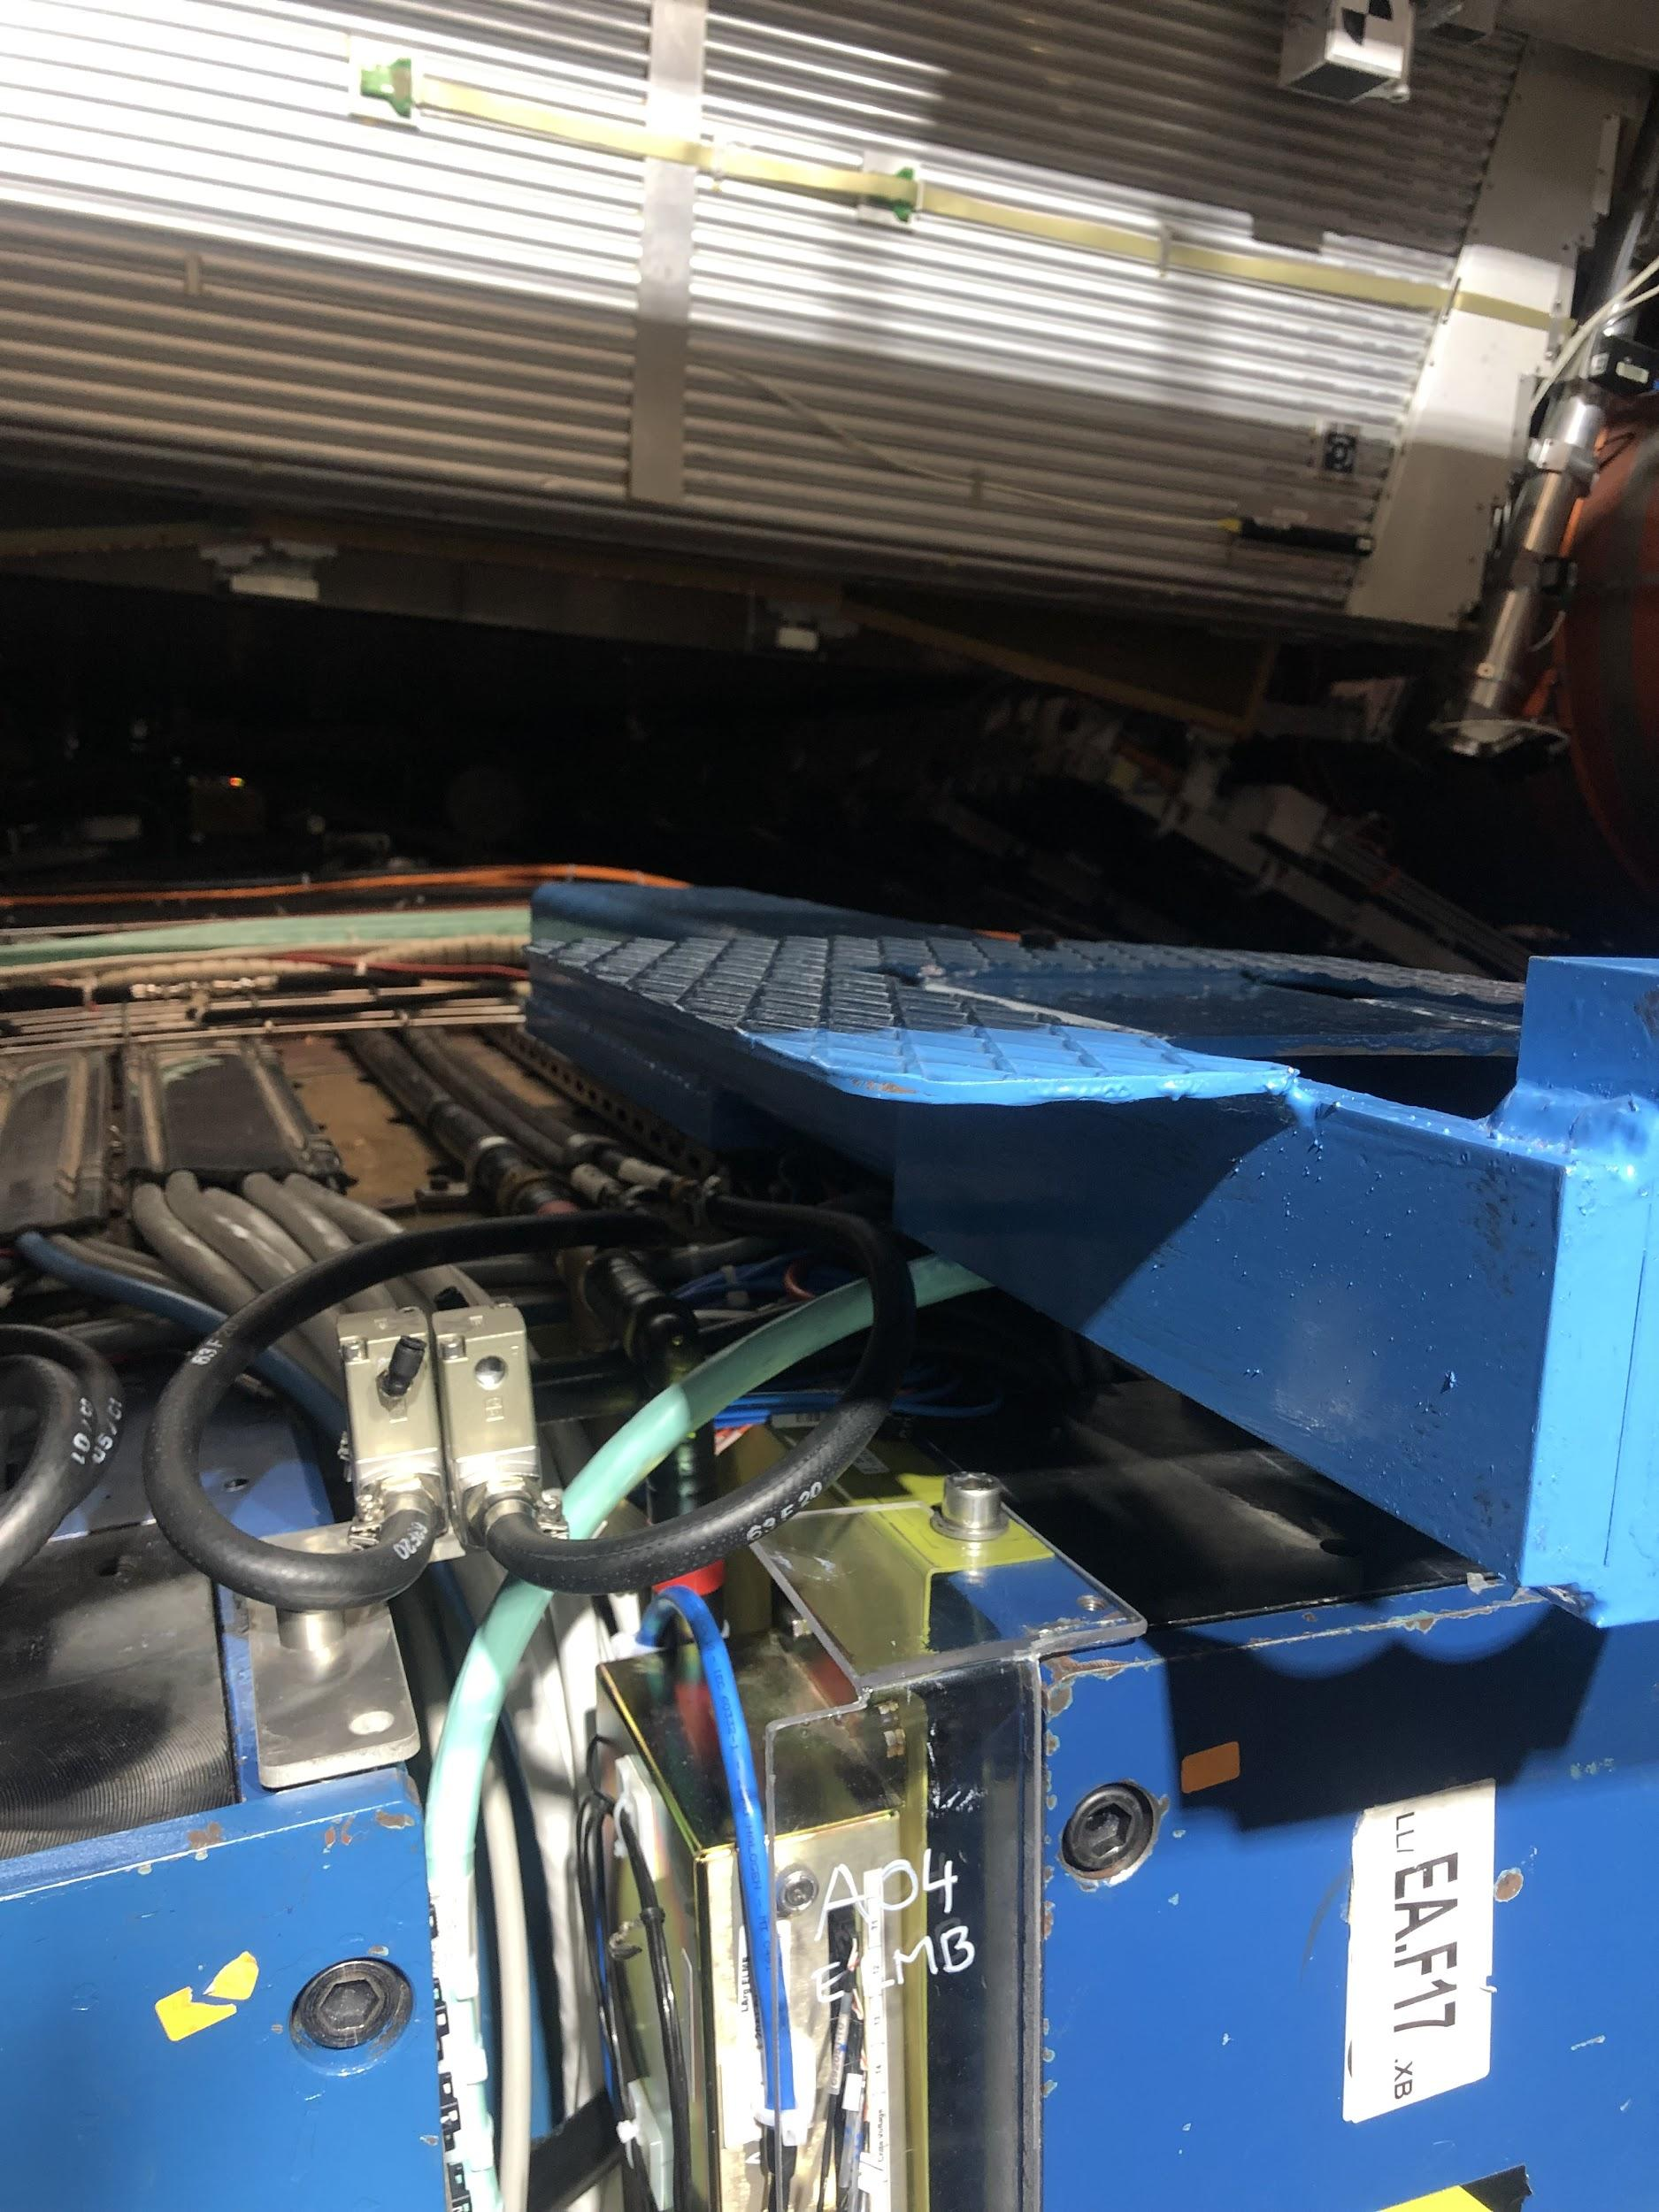
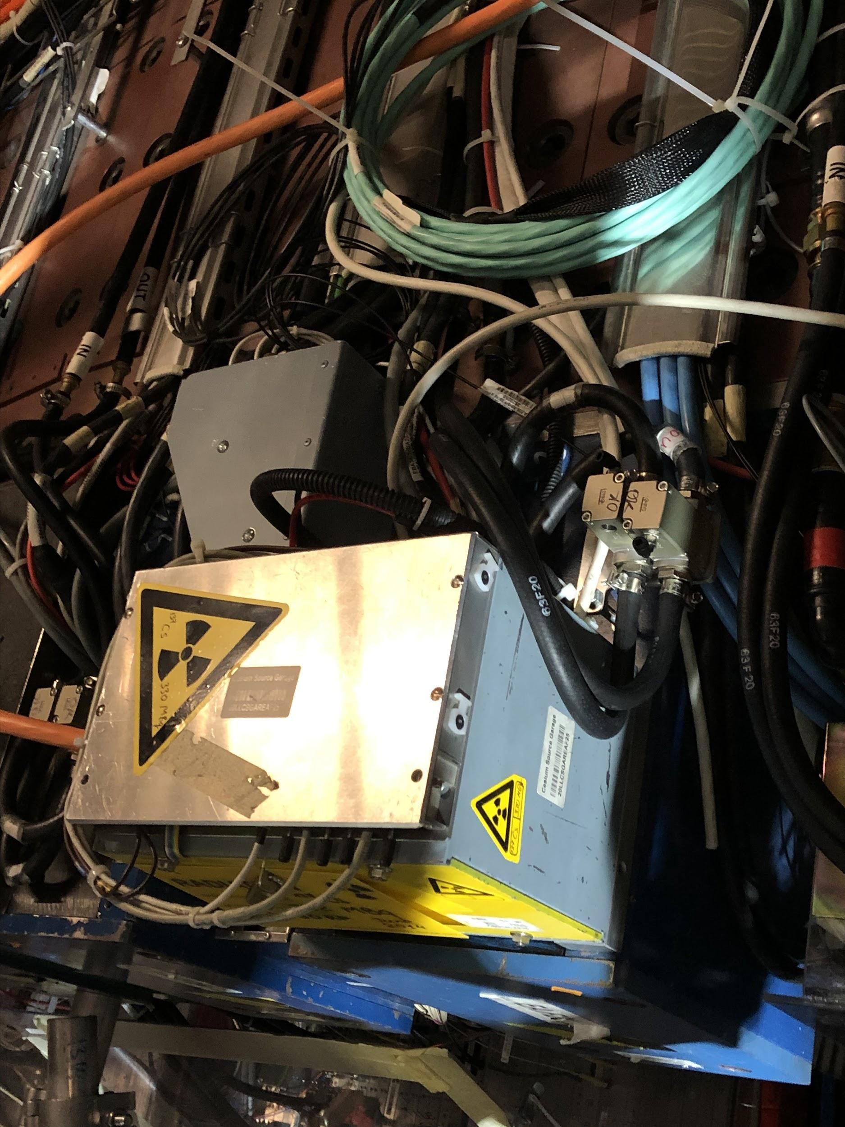
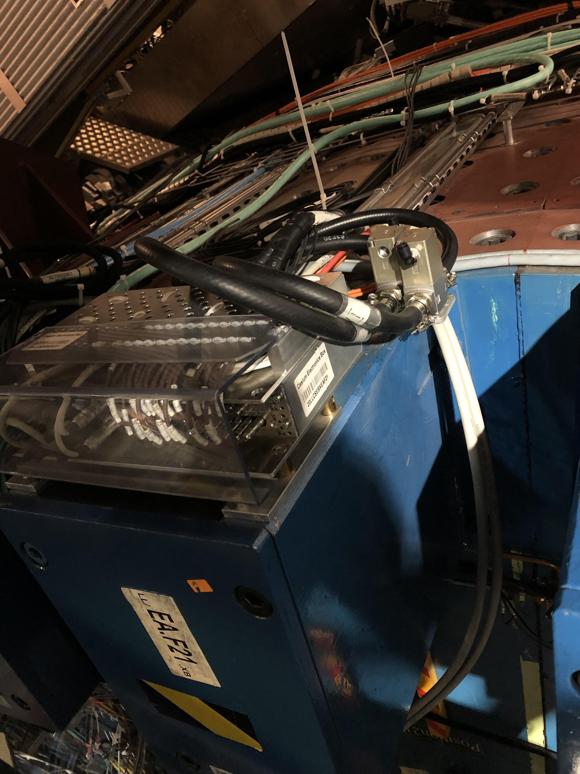
Examples (more complicated)
Middle Beam
Cs source box
Cs electronics box

Slide 7
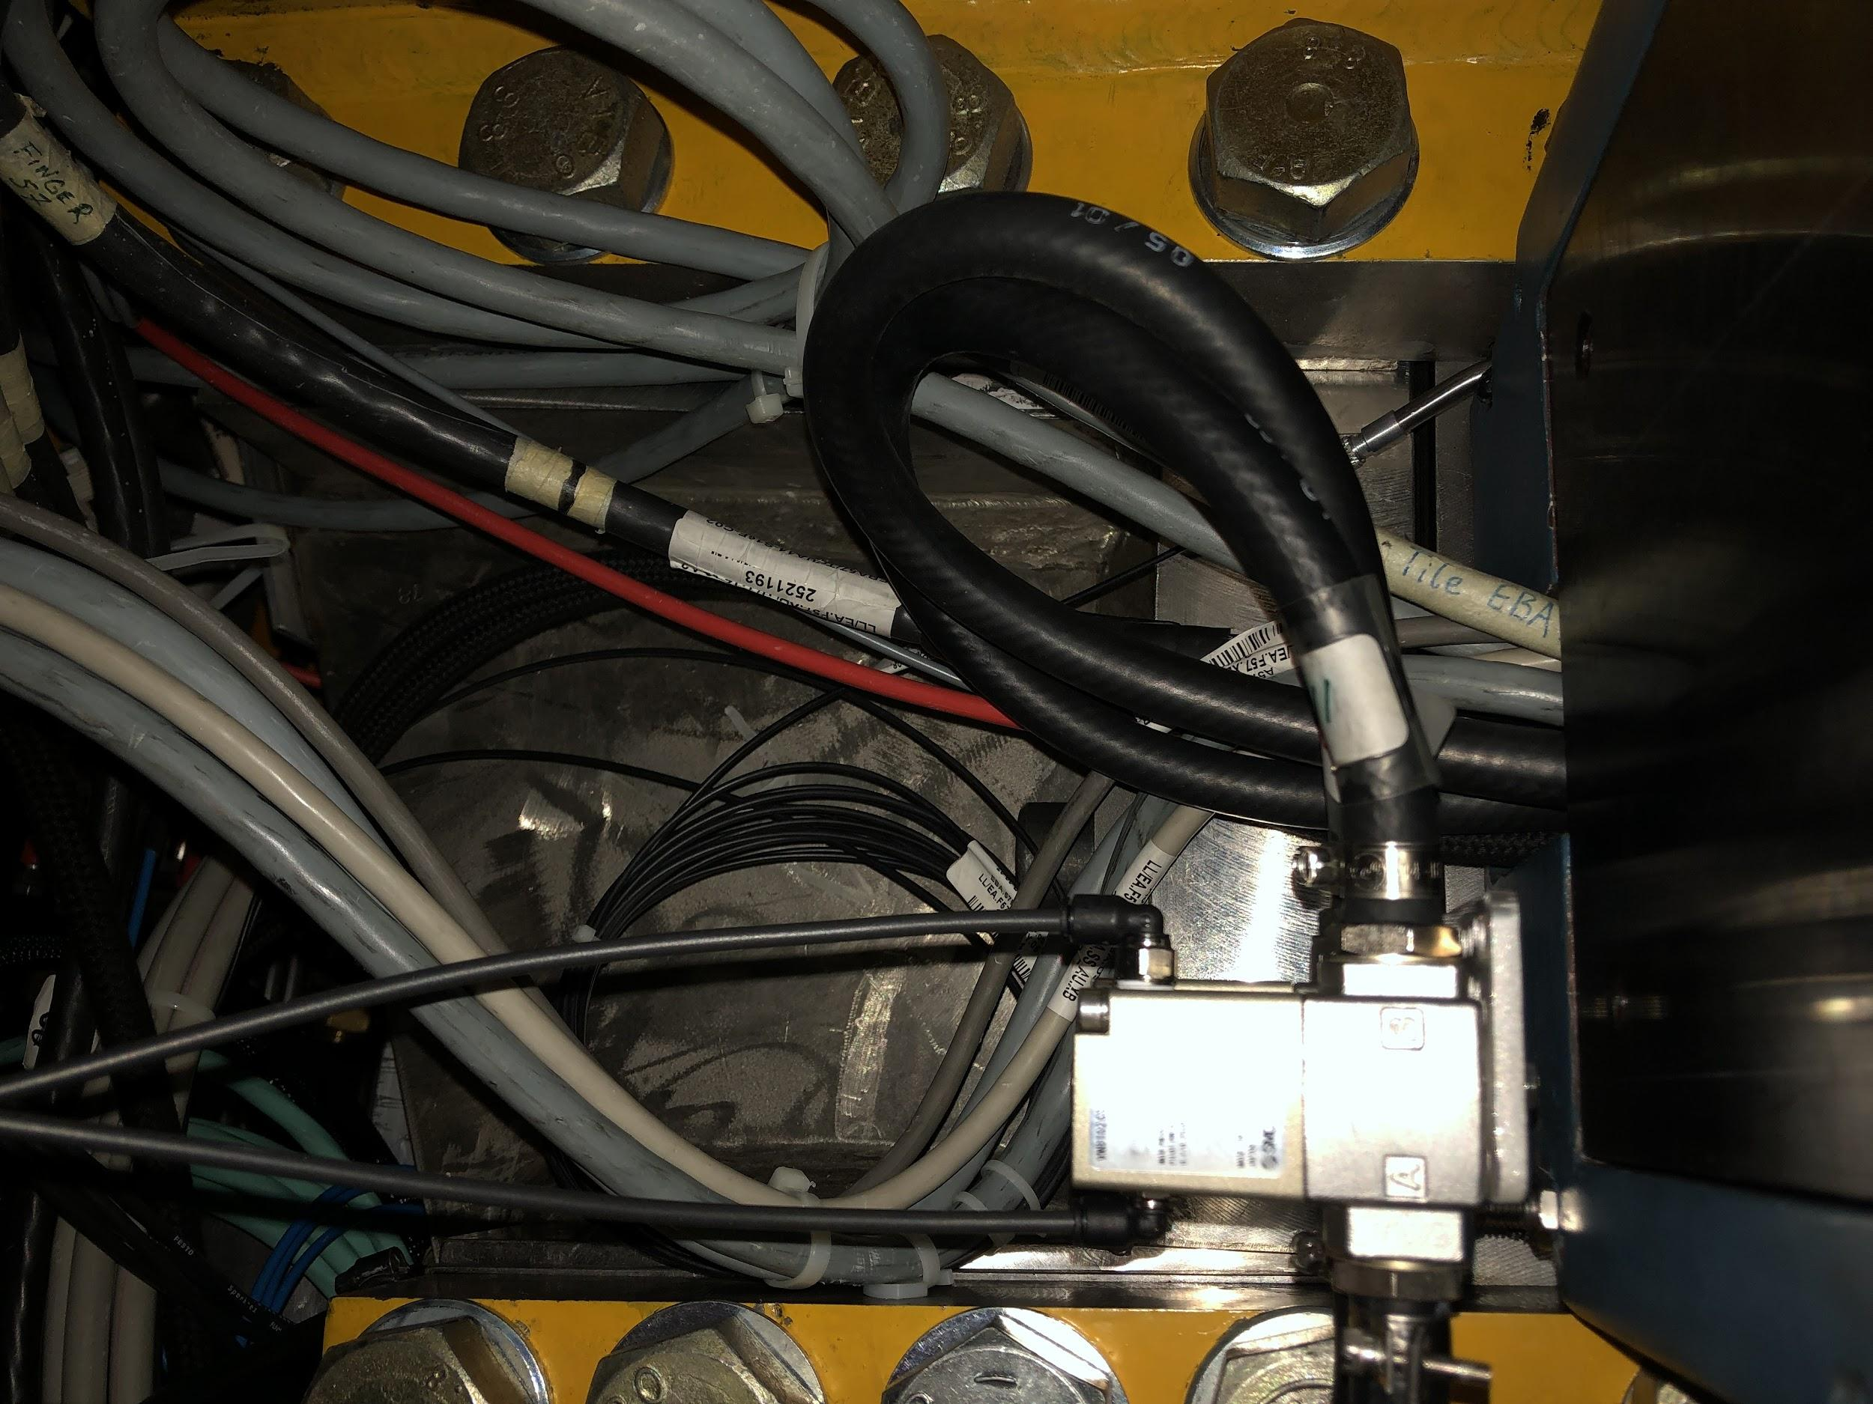
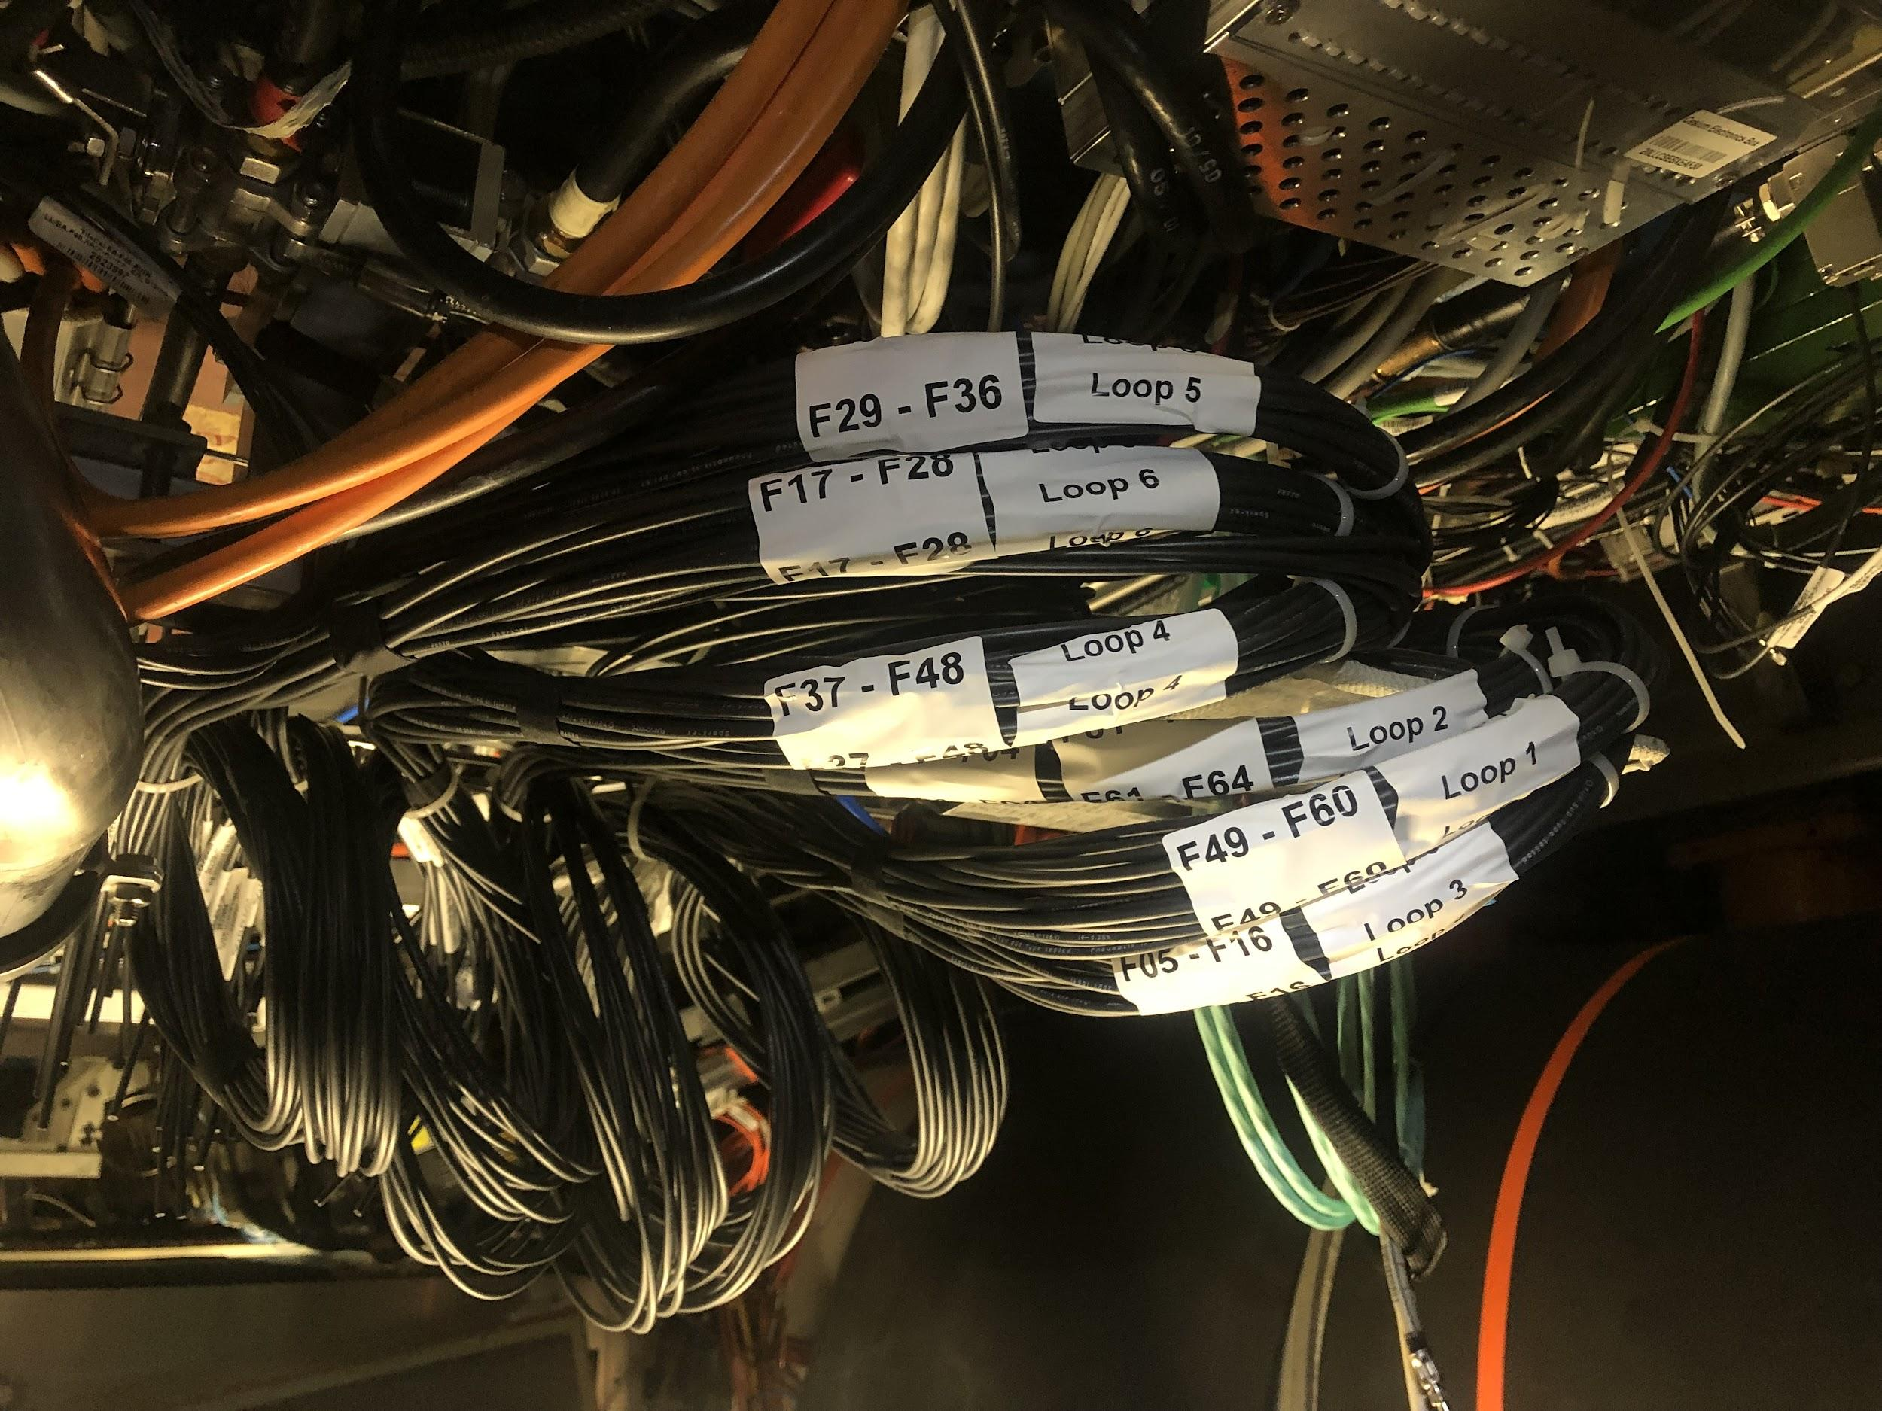
Pneumatic Hoses
Each valve is connected to an air hose which can shut it off
Other side of hoses are gathered at a patch panel

Slide 8
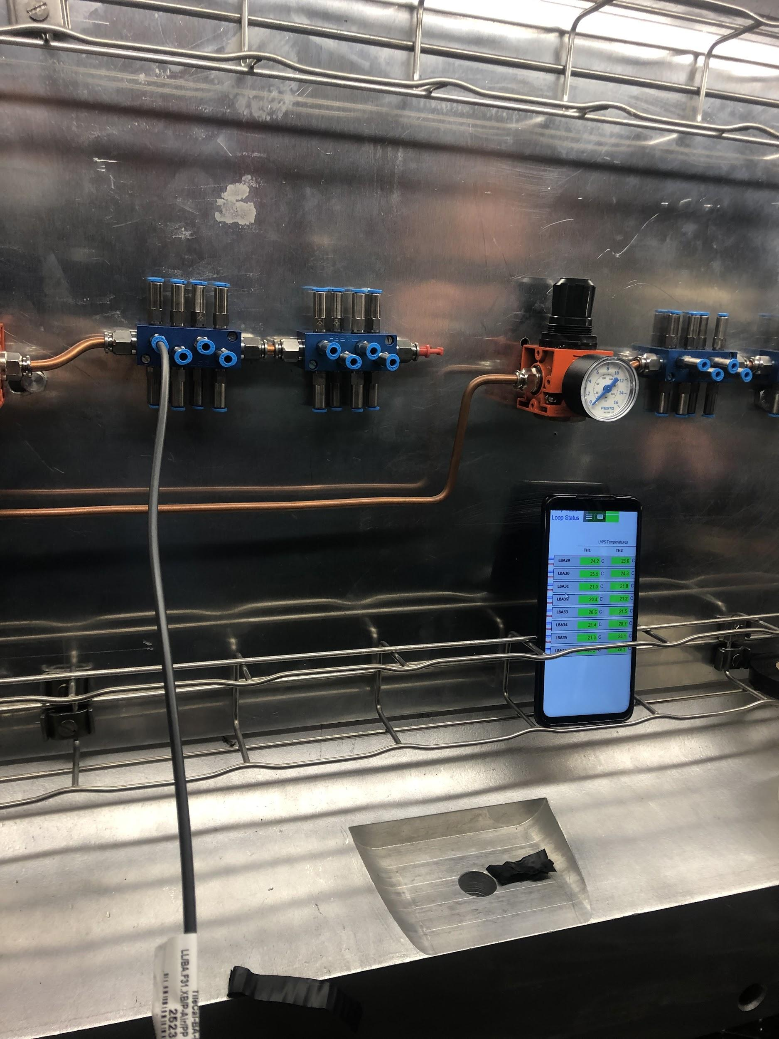
Commissioning
Hoses are gathered near a patch panel where they can be connected to a pressurized system
We check the in and out hoses for each module separately, and confirm they both increase the module’s temperature using DCS monitoring

Slide 9
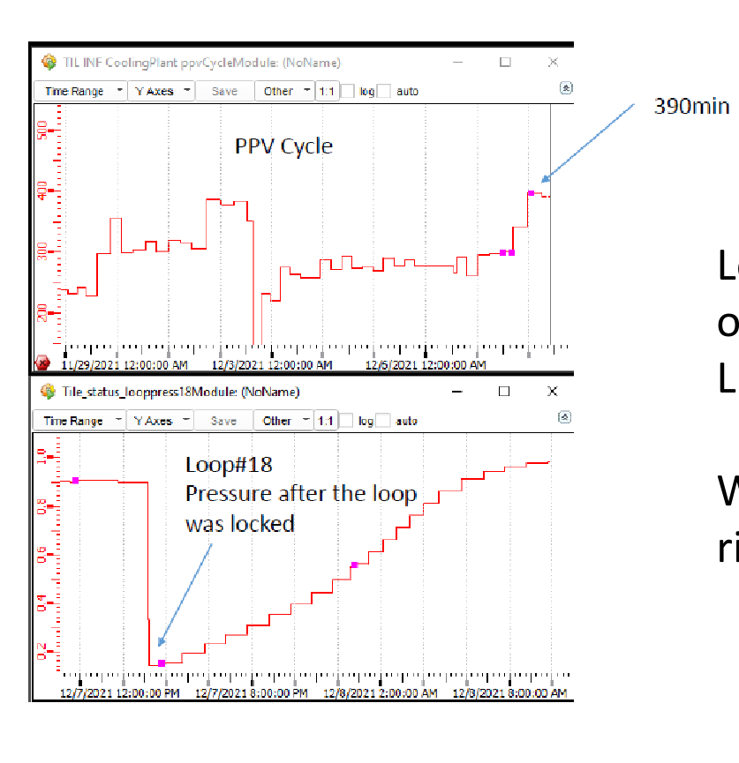
Identifying Leaks
Check PPV cycle
How often cooling system must be pumped down to a lower pressure
Now we can use the air hoses to shut off valves we suspect have leaks, then check PPV cycle to see if it improves

Slide 10
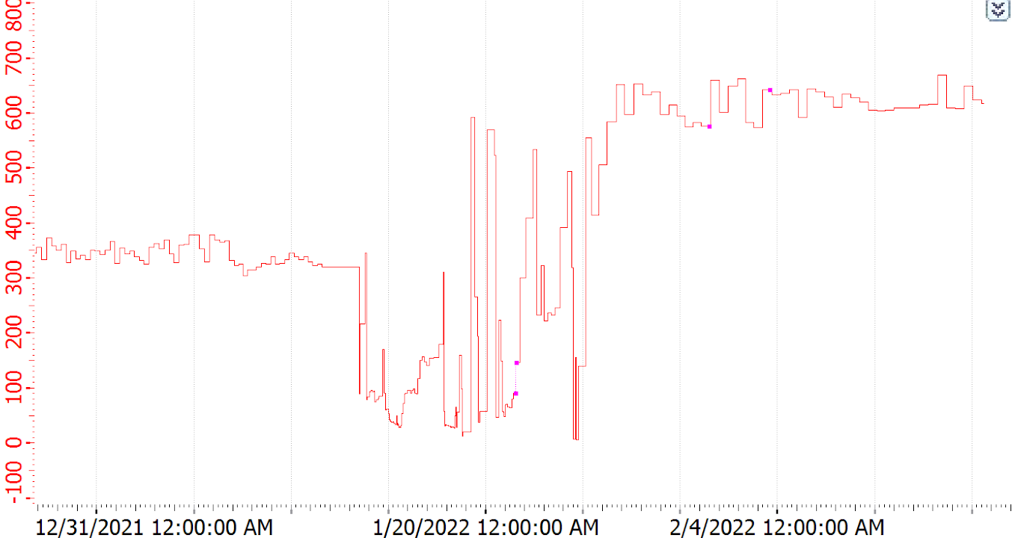
Cooling Leaks in January
LBC33, LBC49, EBC48 and EBC49 fixed. 19-23 Jan
Maintenance of cooling station + EBC closed
11-12 January
EBC closed
24th January
EBC opening
13 January
Conflict with diffusion pump cables
LBC60 isolation valve rubber hose connection damaged by metallic PIN (on the EBC)
24th January

Slide 11
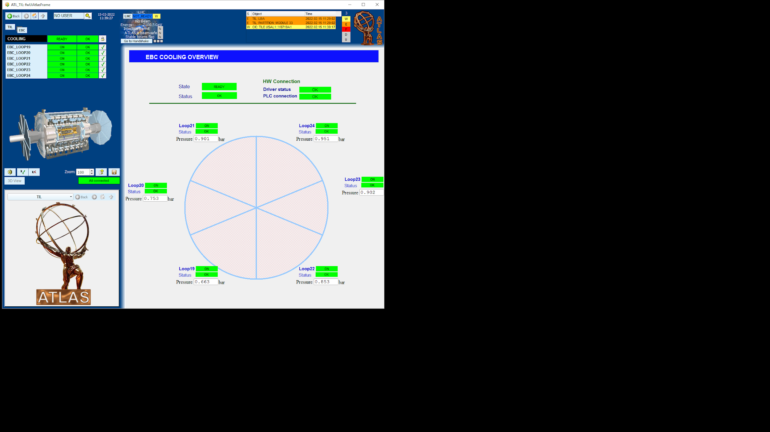

Map of Modules with Leaks
Identified locations using isolation valves
LBC60
LBC33
EBC49
EBC48
LBC49

Slide 12
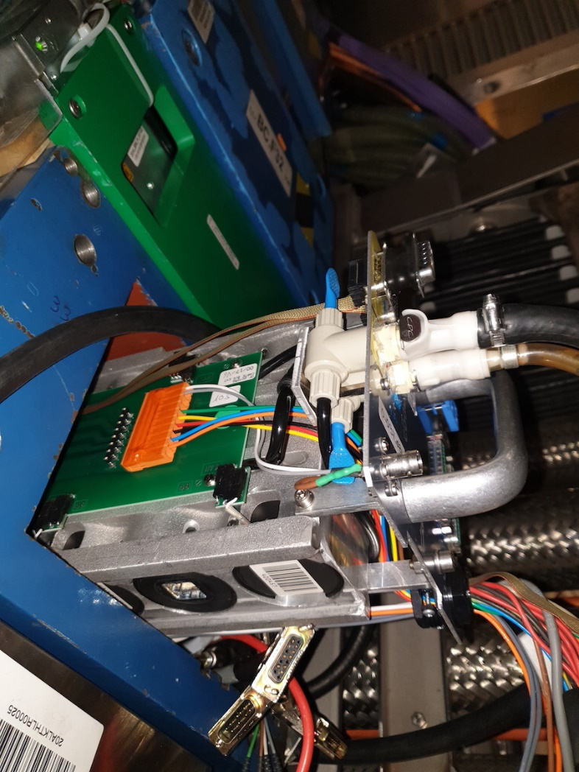
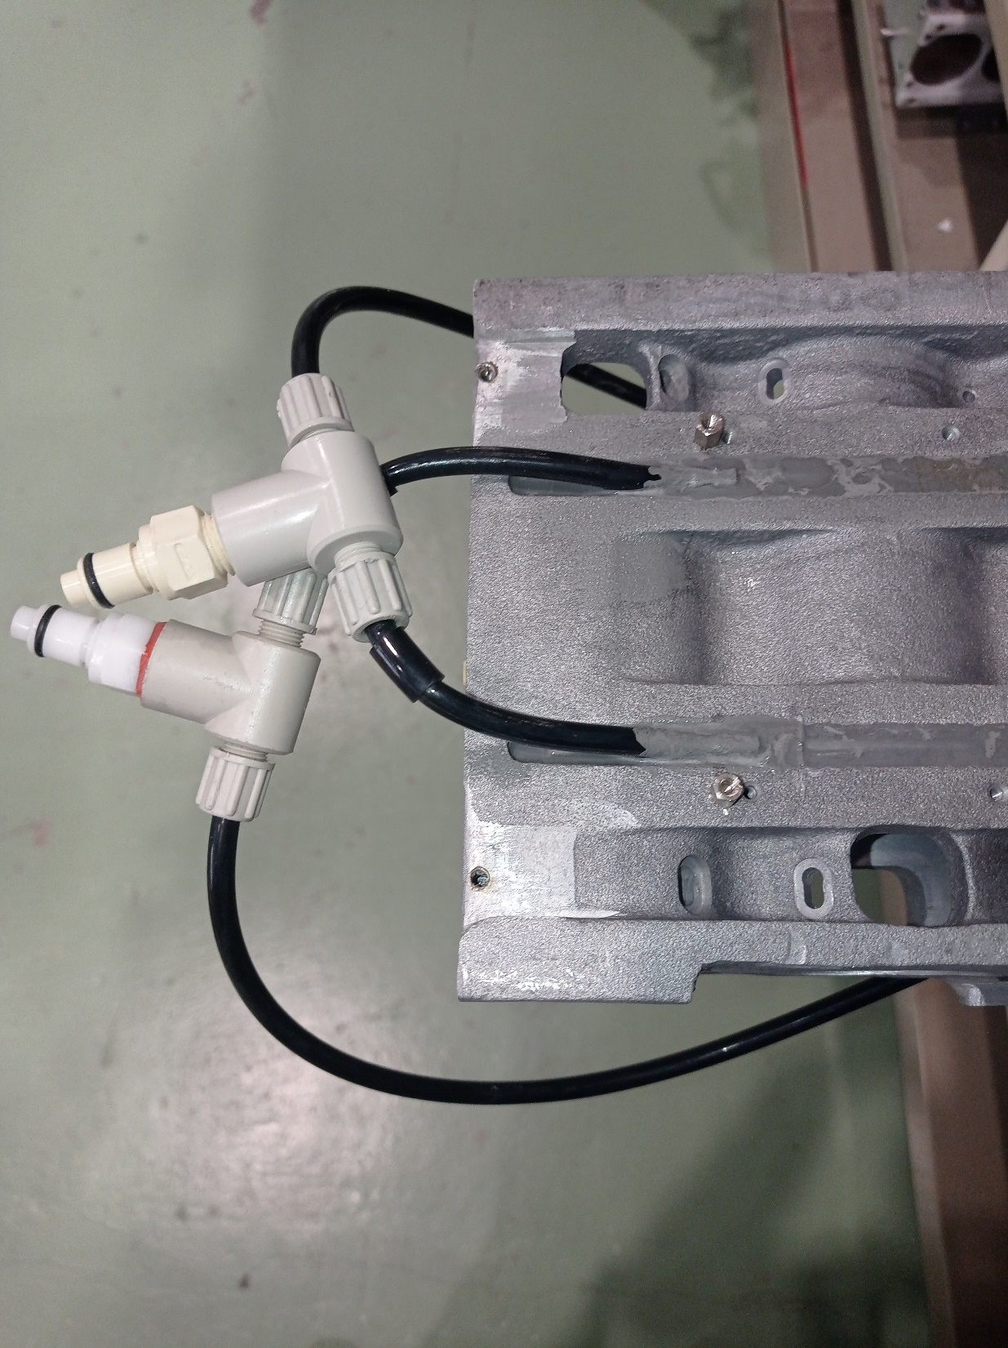
Cooling Leaks in January
Opened drawers and discovered leak was in HV side of drawer – PPV cycle increased greatly when we disconnected it
Used plugs to bypass that side of the cooling
PPV cycle increased to about 800 minutes (highest it’s been in a long time!!)
Unsure why HV side always had leak. We think that turning the cooling system on/off as much as we had been was not good.
MB-Side
HV-Side

Slide 13
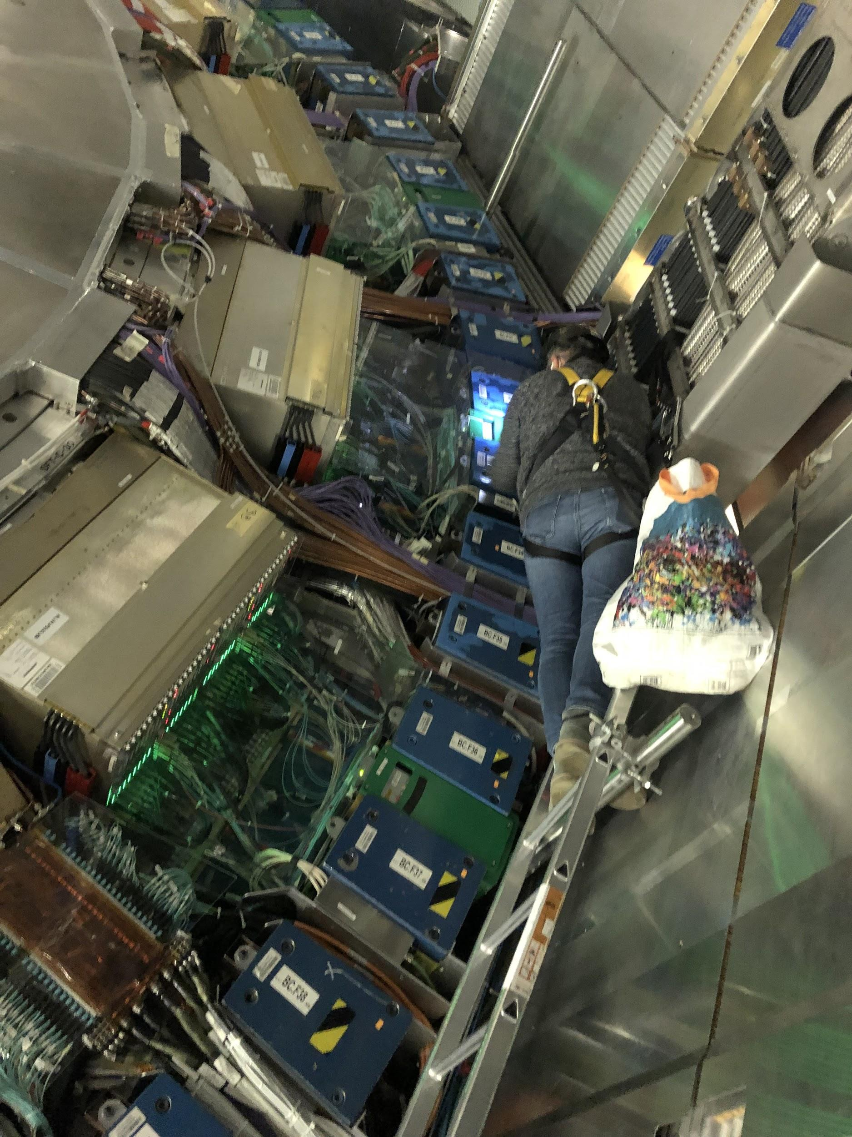
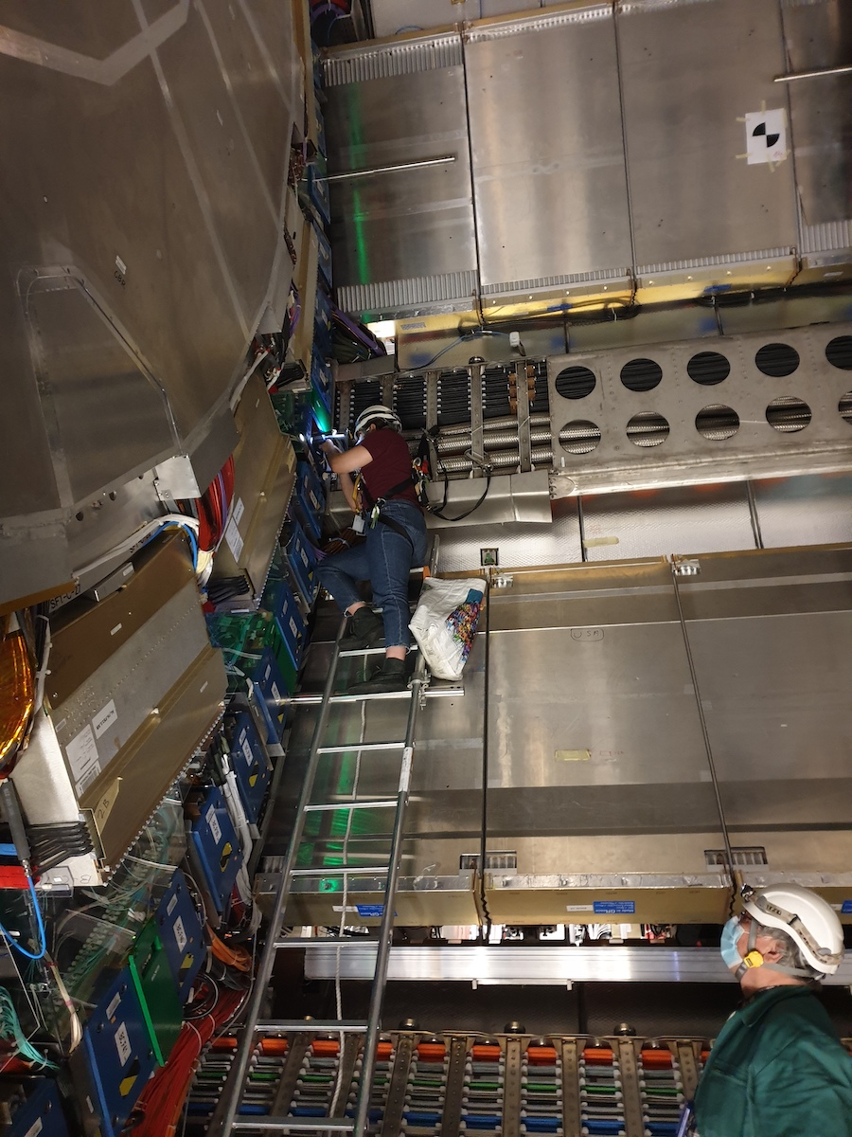
HV Bypass: LBC 33
First drawer we fixed
Very awkward location as all scaffolding had been removed
Katie, Oleg, and Stan helped to fix the problem

Slide 14
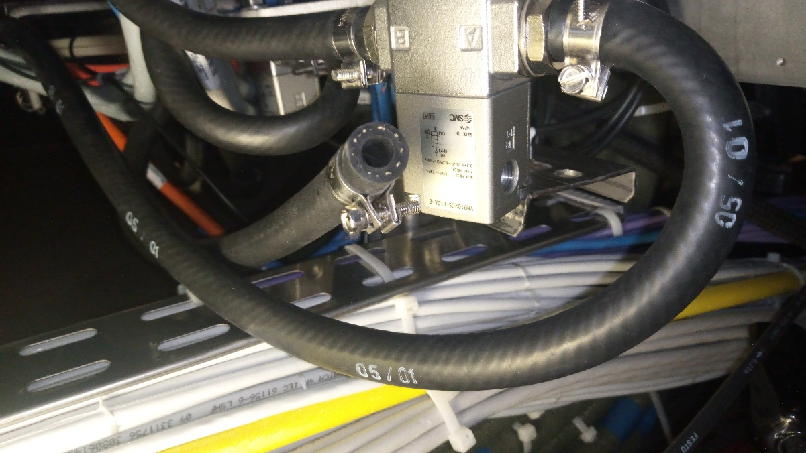
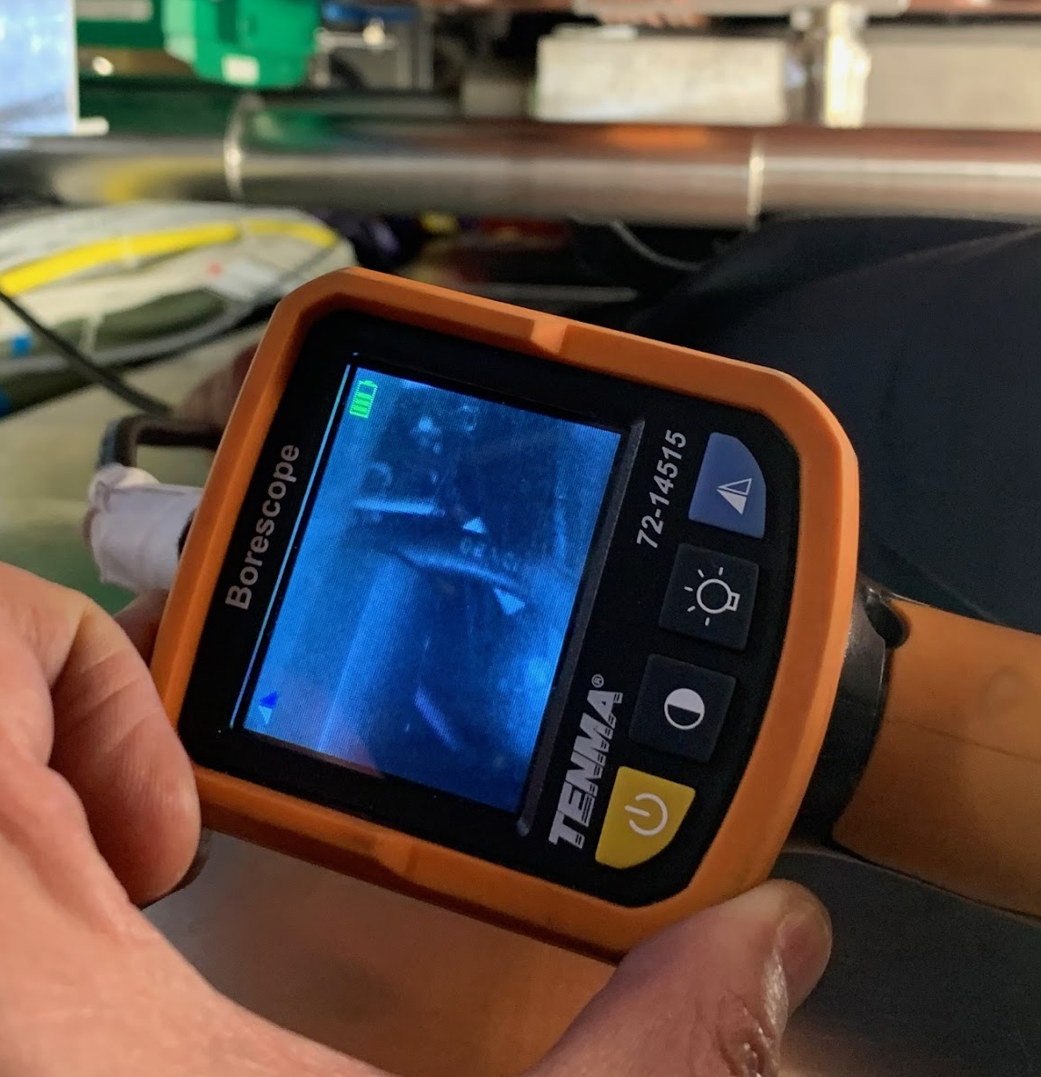
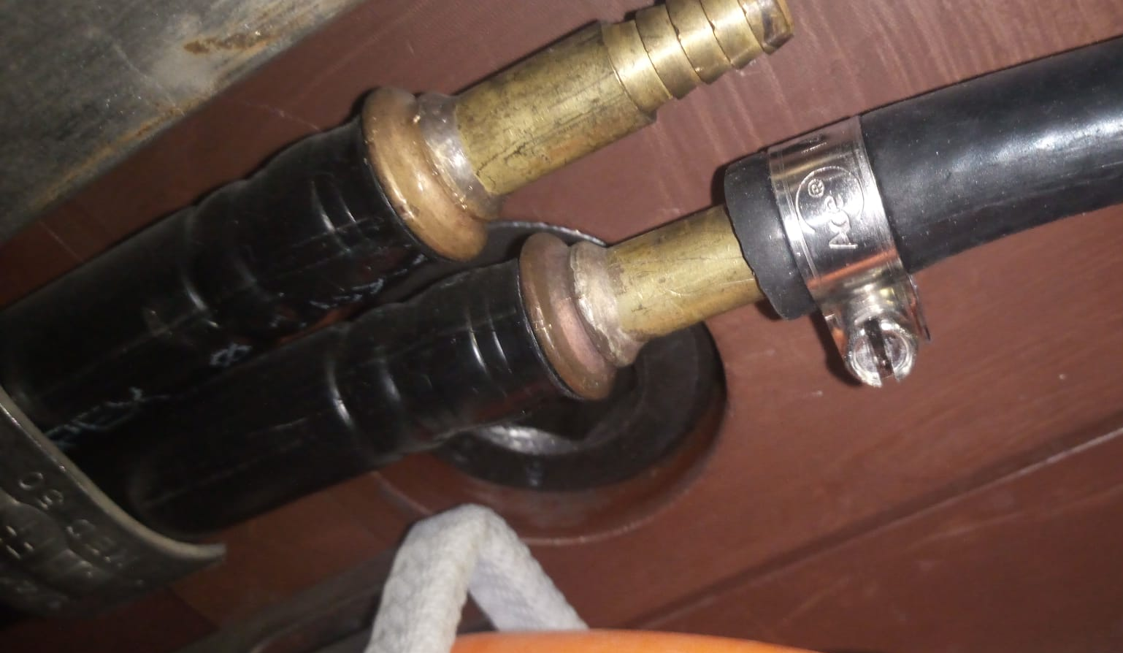
LBC60 Leak
Rubber hose
Metallic PIN

Slide 15
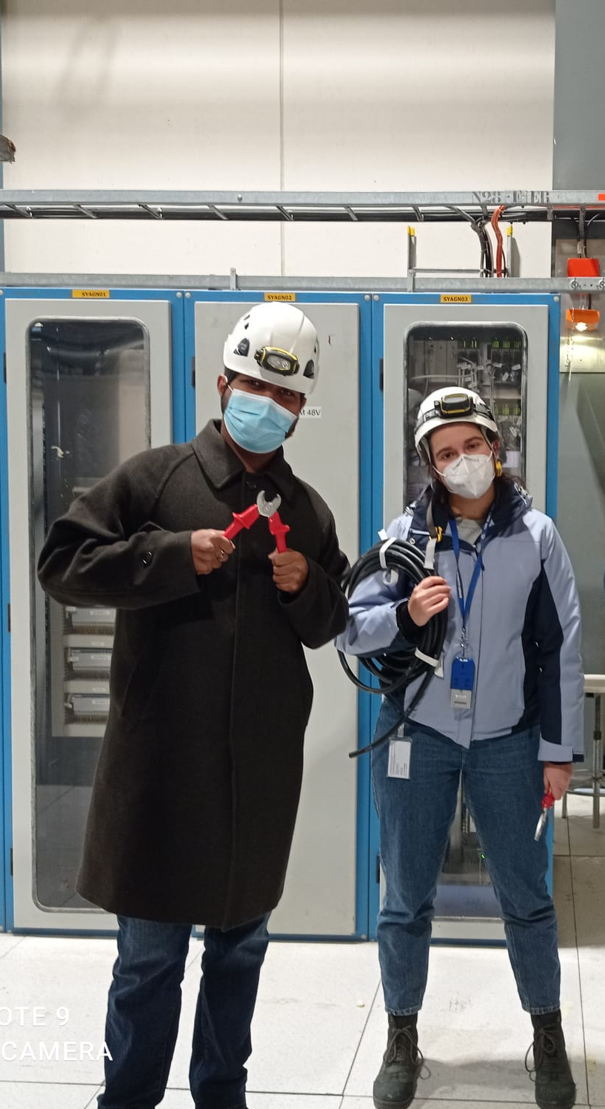
Current Status
All Tilecal modules have valves
We have fixed all known leaks, and the PPV Cycle is incredibly high at 800 minutes!
We have ~20 extra valves in case any need to be replaced in the future

Slide 16
Charge Injection System (CIS)

Slide 17
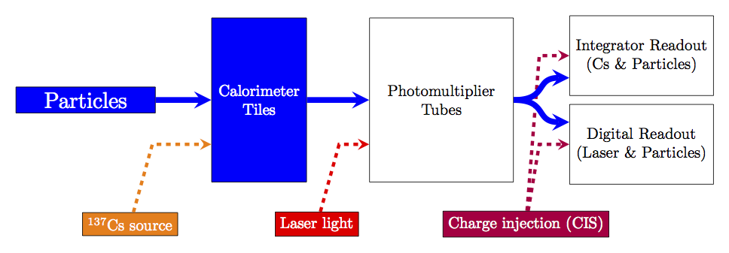
Overview
Calibration system for front-end readout electronics
Simulates physics signals by injecting a known charge and measuring the electronic response
Characterizes each readout channel with a CIS constant

Slide 18
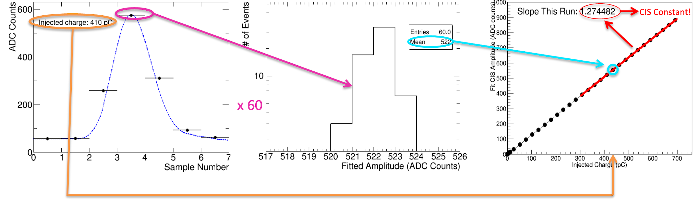
CIS Constant Calculation
60 injections of a set charge sampled 7 times
15 steps varying phase between injection and sampling
4 capacitor discharges each
Mean amplitude of pulse measured for different charges
Amplitude (ADC counts) vs charge (pC) fit gives CIS constant
For each of ~19,700 channels!

Slide 19
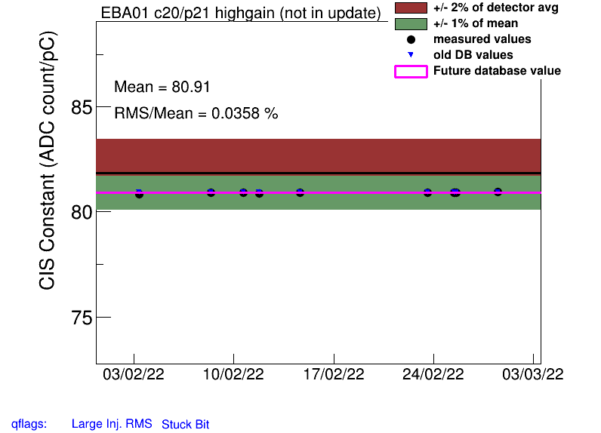
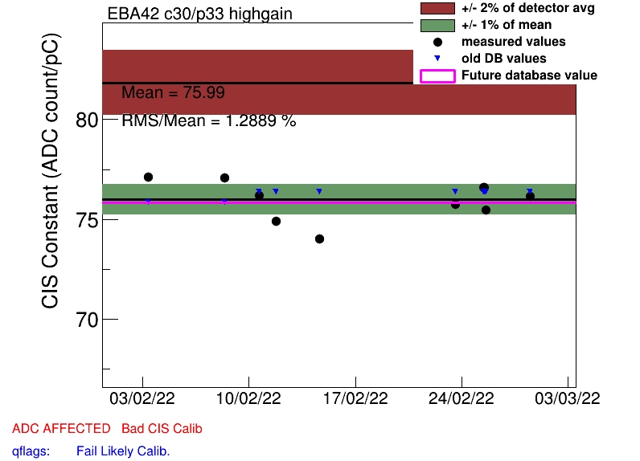
Procedure
Generate plots of CIS constants vs time over last month
Go through plots by hand to check validity of constants
Good CIS plots are very stable over time and close to the detector mean
Manually make any necessary changes (described on next slides)
Upload corrected constants to database
Good CIS
Bad CIS

Slide 20
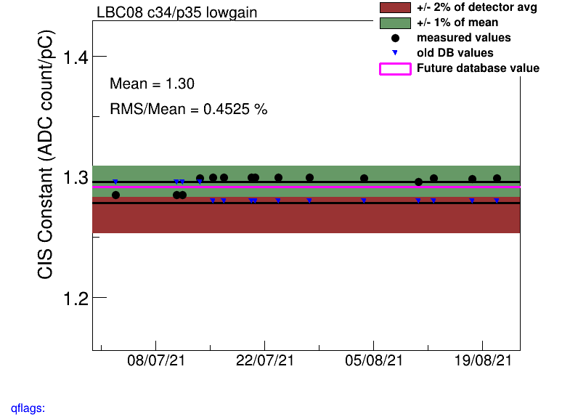
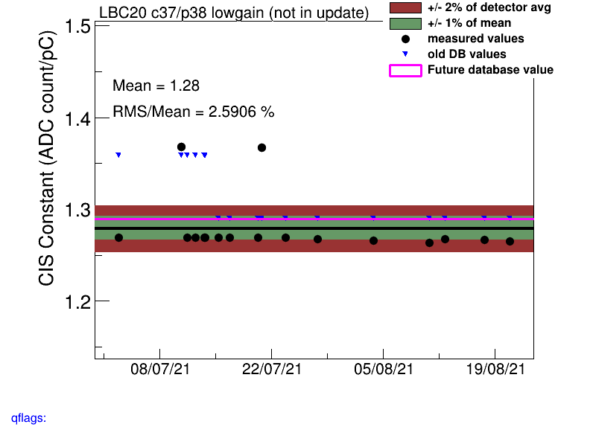
Recalibration
Often there is a constant shift in the CIS constant at some date, or 1-2 outlier points that skew the mean
Solution: run over a shorter time period, so long as the newer value appears stable

Slide 21
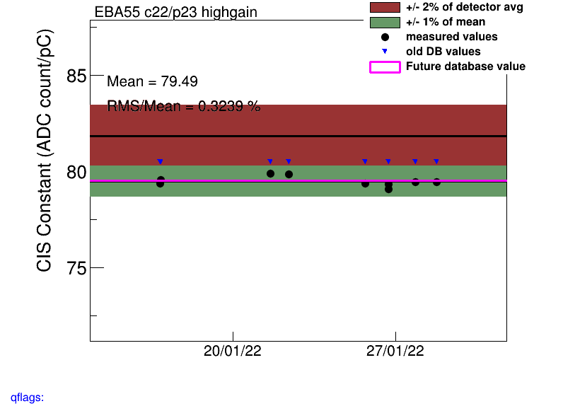
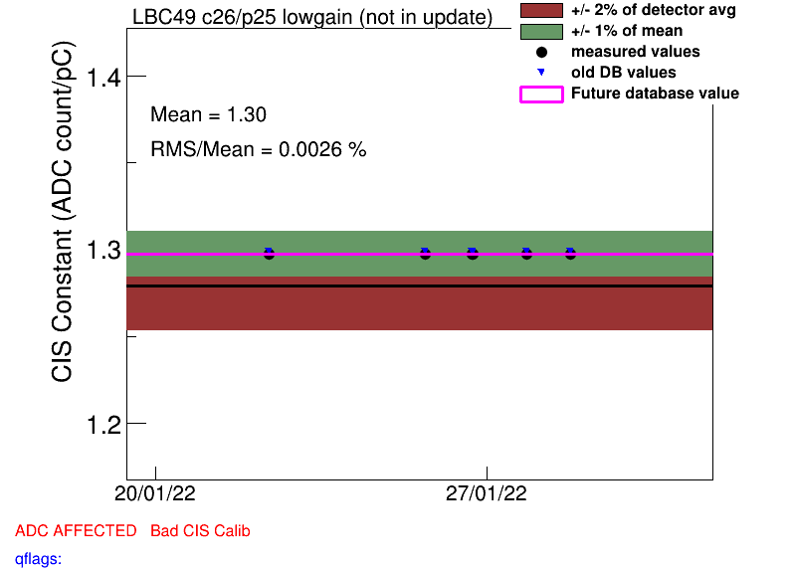
Flag Update
Sometimes channels are incorrectly flagged as BadCIS, or vice versa
Notes:
Add some particularly dramatic examples!!!

Slide 22
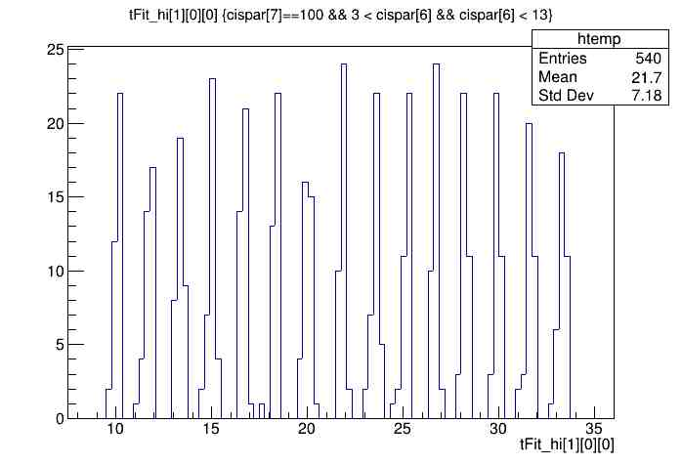
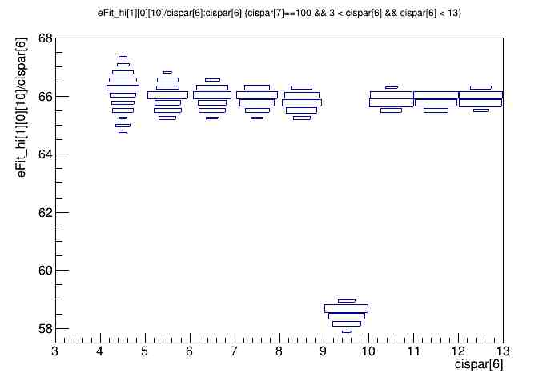
Timing and Amplitude/Charge Ratio
Timing should be consistent across all valid runs, typically in the range of (-15, 10) ns. Here, it’s shifted by +25 ns.
Amplitude/charge ratio for this CIS run in LBC highgain is unstable, so we should not use it.
Notes:
Add examples!!!

Slide 23
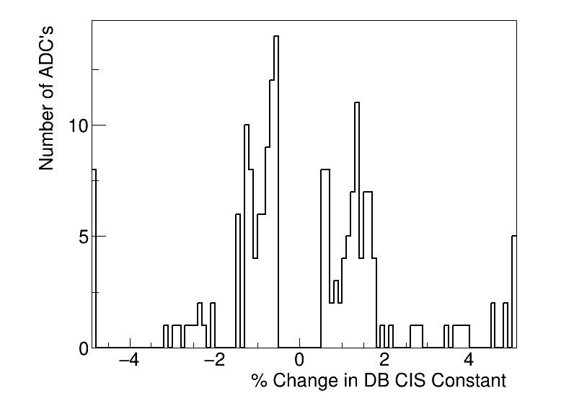
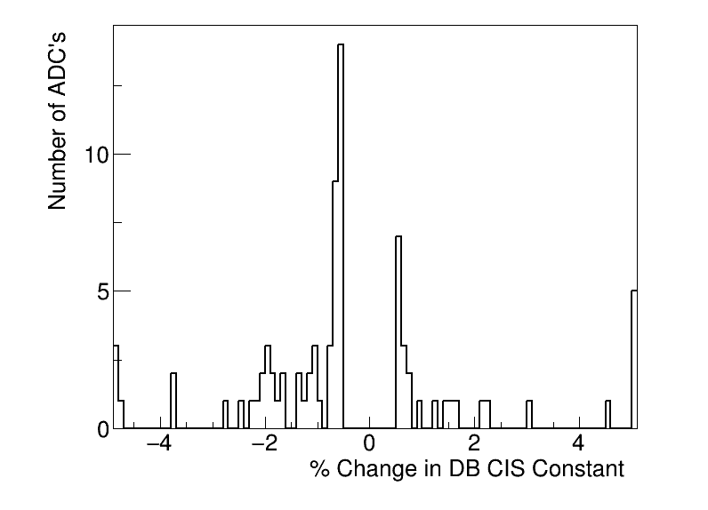
CIS Update Summaries
January
CIS runs from Jan. 16-31
191 channels updated
0 with >5% change
February
CIS runs from Feb. 1 - March 1
81 channels updated
8 with >5% change

Slide 24
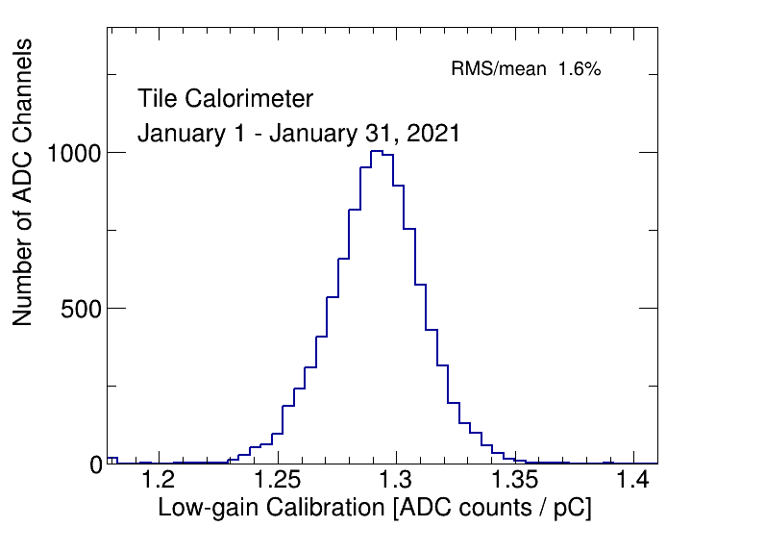
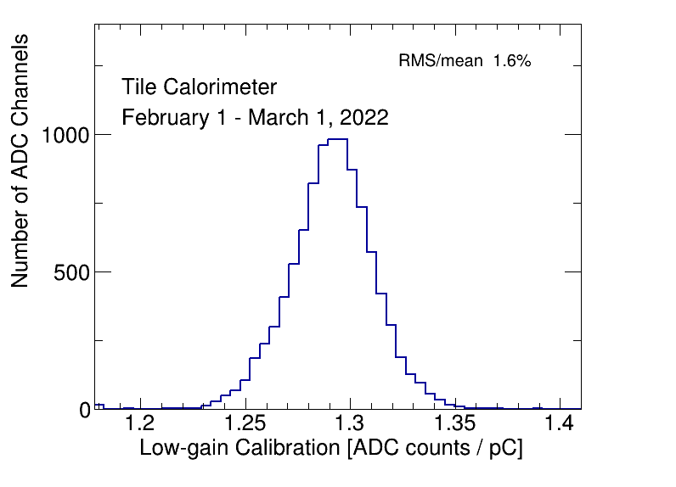
CIS Constant Distributions (Low Gain)
Should be Gaussian and centered around 1.29 ADC counts/pC

Slide 25
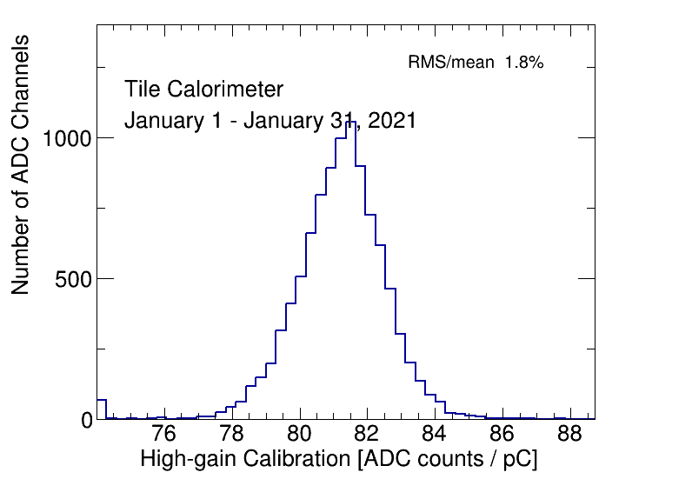
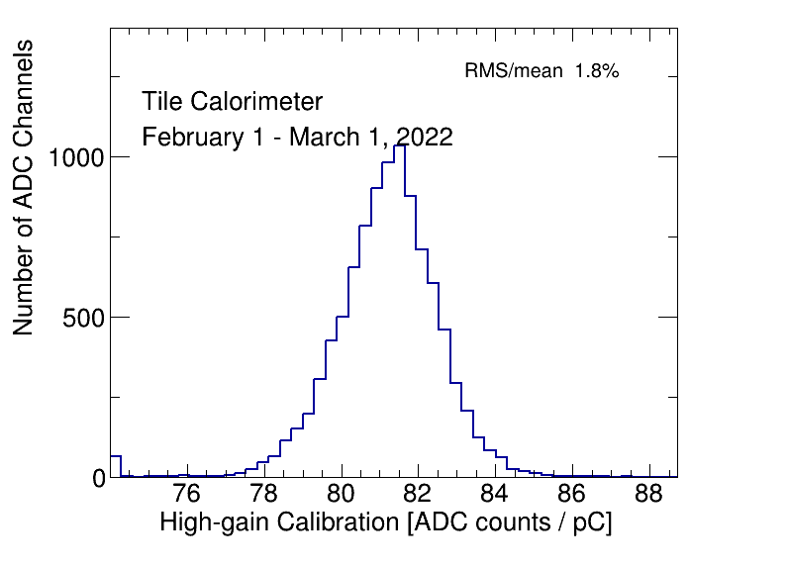
CIS Constant Distributions (High Gain)
Should be Gaussian and centered around 81 ADC counts/pC

Slide 26
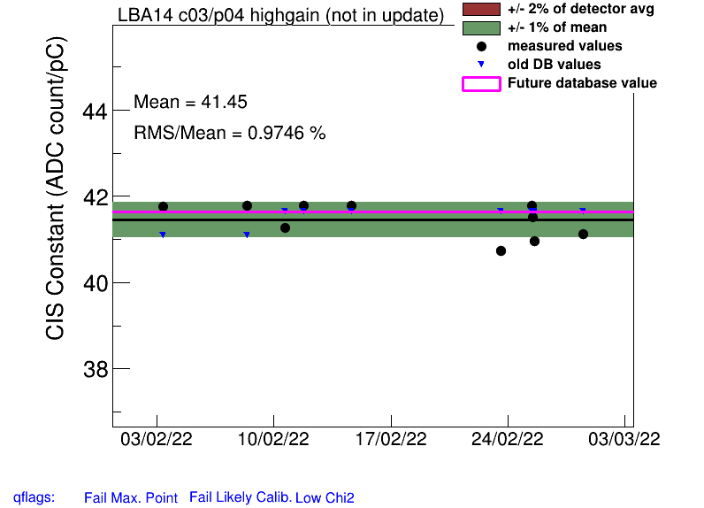
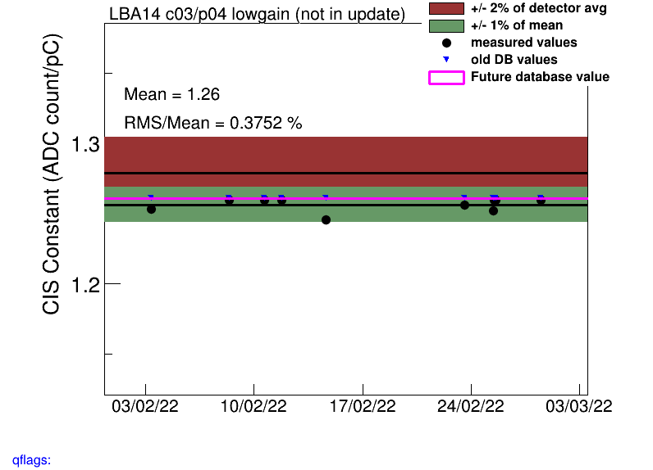
CIS Constant Distributions (High Gain)
This bump on the HG distribution is from LBA14, which is expected to be at half gain but is not to be marked as BadCIS

Slide 27
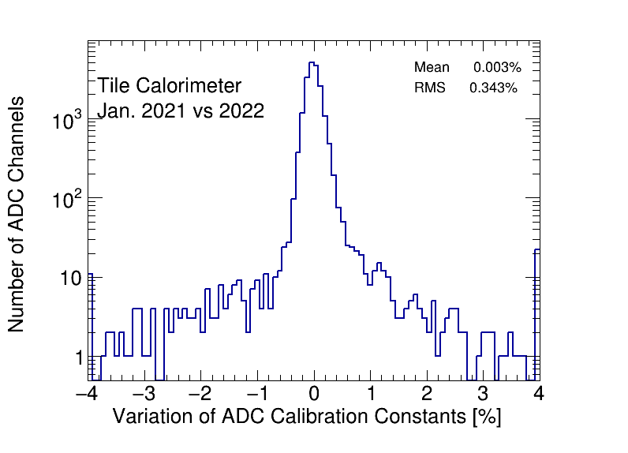
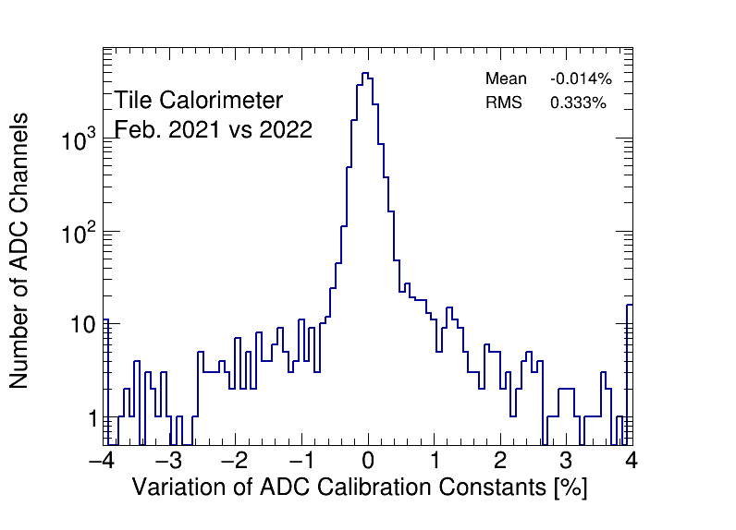
CIS Constant Stability

Slide 28
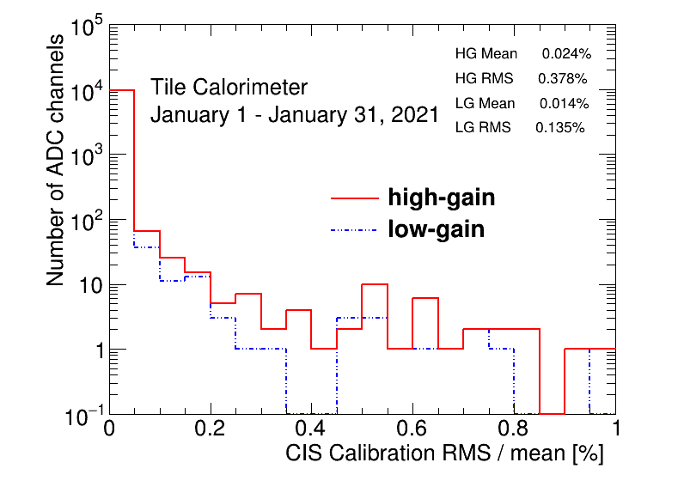
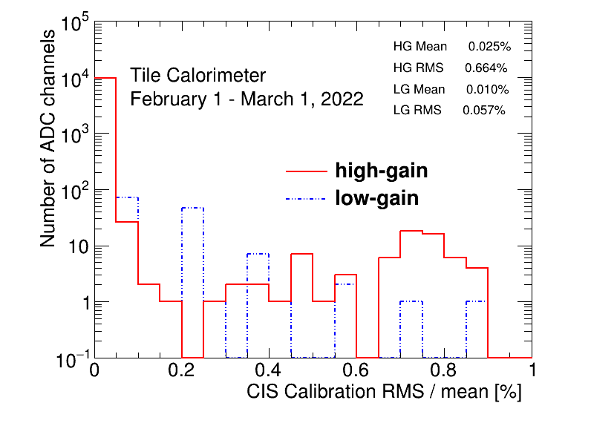
CIS Constant RMS/Mean

Slide 29
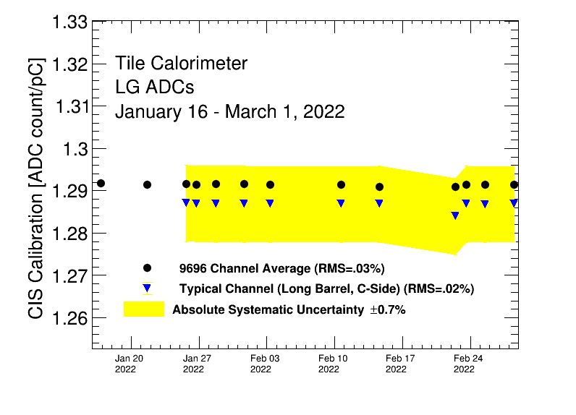
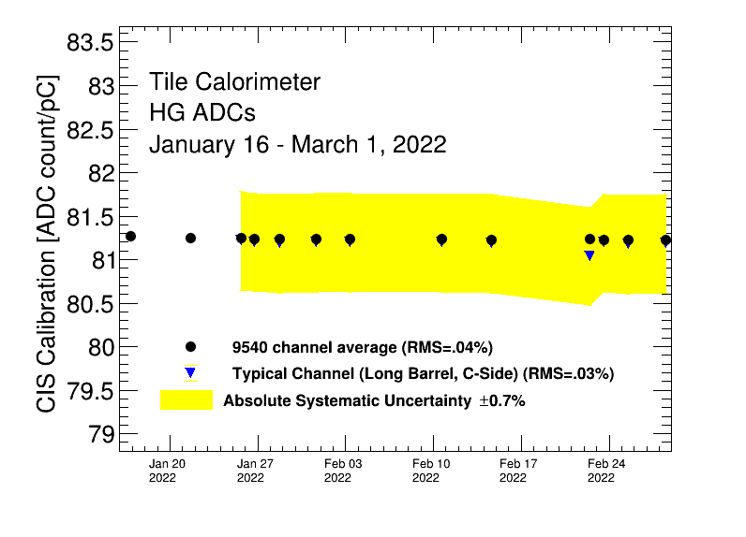
Detector Stability
Entire detector was not on during this period

Slide 30
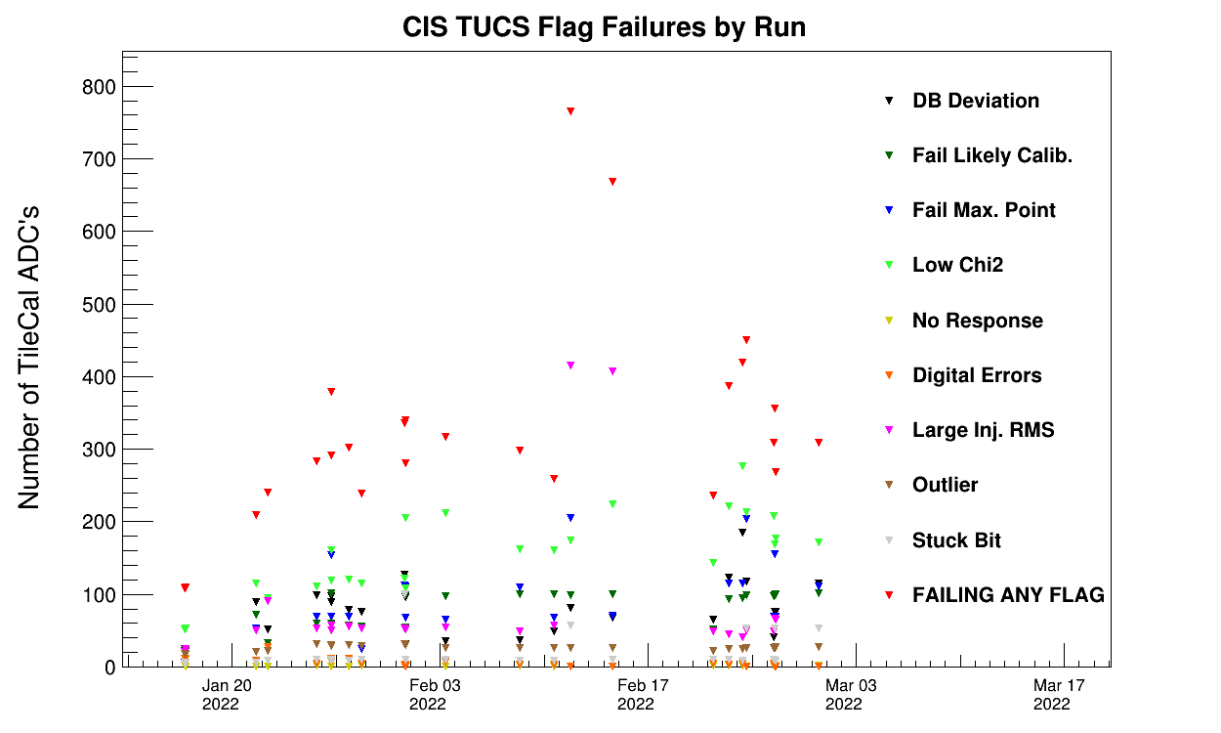
TUCS Quality Flags

Slide 31
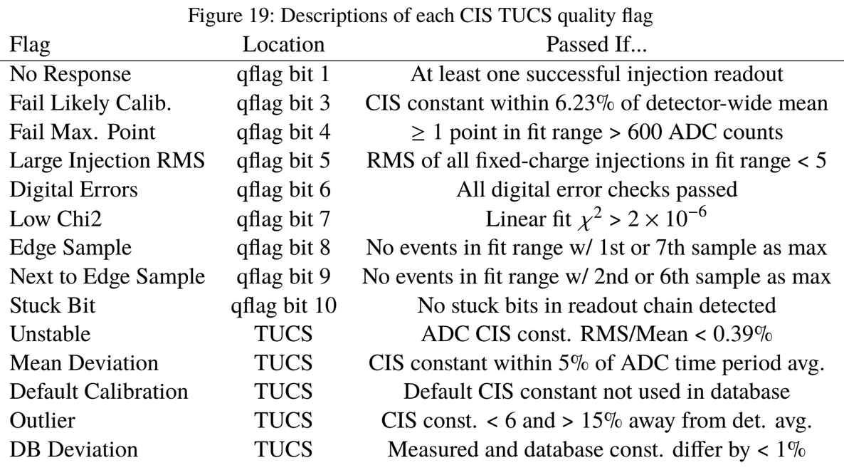
TUCS Quality Flags

Slide 32
LAr Simulation Work

Slide 33
Energy Correction due to Accordion Structure
Motivation for the work:
ATLAS geometry is complicated which makes simulation jobs slow
Solution to this problem: FastCaloSim framework
It provides fast simulation of particle energy response of ATLAS detector by simplifying the geometry
In particular, accordion feature in LAr Calo is replaced by prismatic cells
We want to account for effects of accordion structure on the energy response of LAr detector post FastCaloSim processing
Goal:
To obtain a statistical model of layer energy modulation as a function of phi arising from accordion structure of LAr Calorimeter.
Final product: A functional form (TGraph) for the layer energy modulation in each EM layer of LAr Calo
Strategy: Use muon events generated at the center of detector to sample layer energy dependence on phi

Slide 34
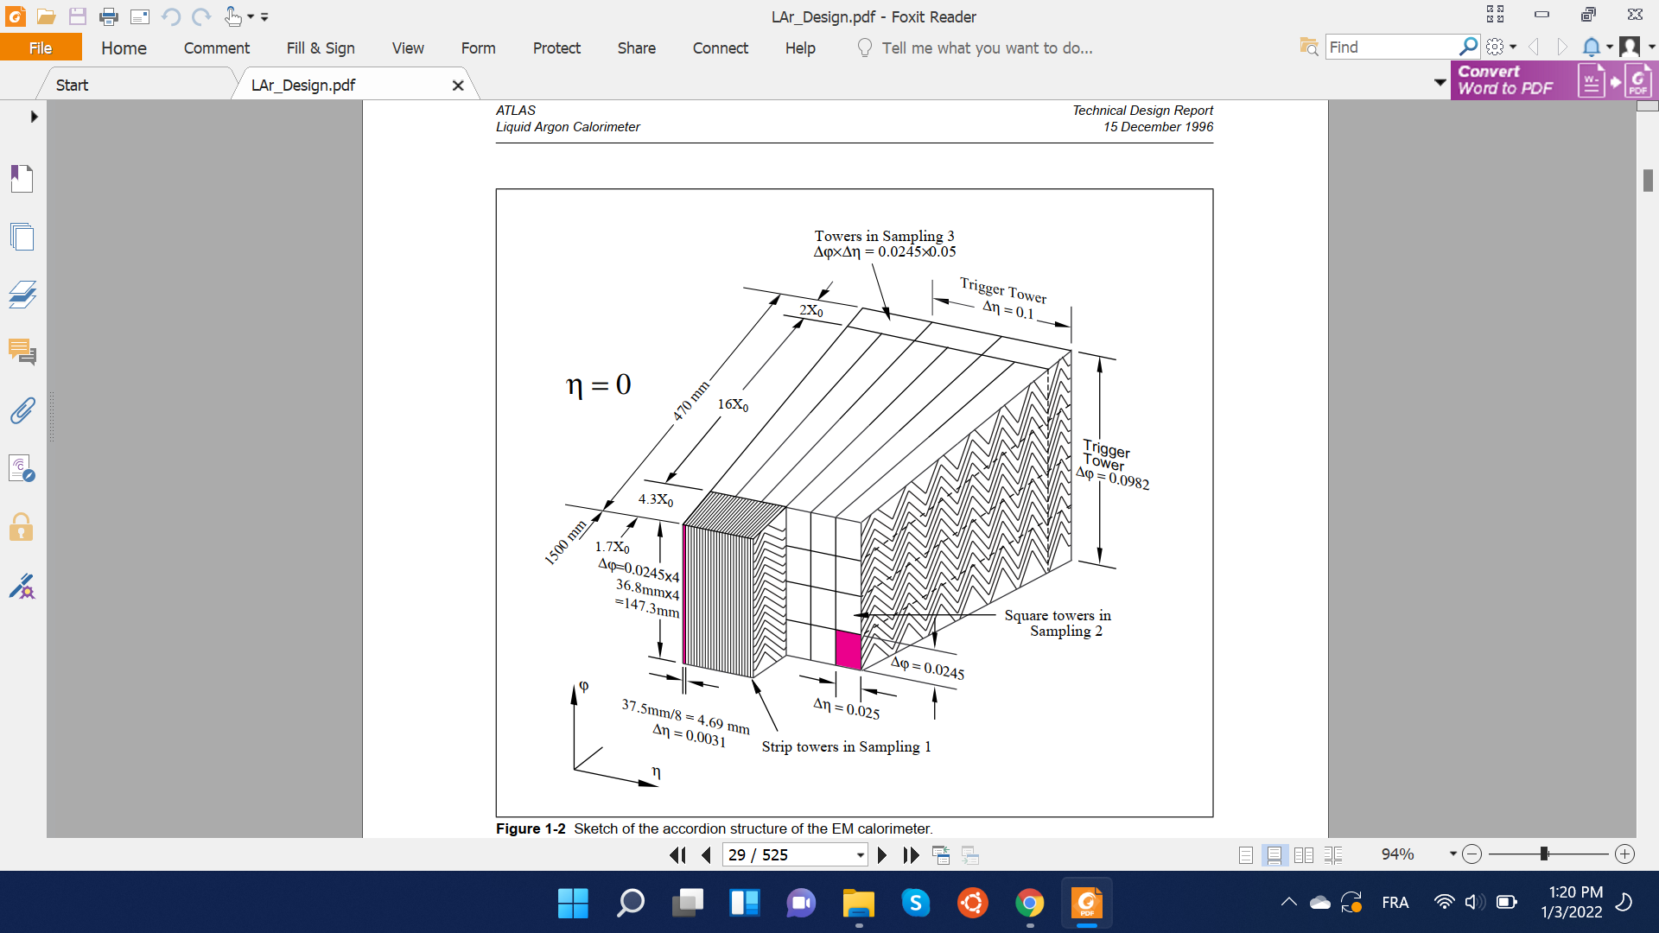
Accordion Structure & FastCaloSim
FastCaloSim is a framework that provides fast simulation of particle energy response of ATLAS detector.
Key simplification for fast simulation in LAr EM layers: idealize accordion wiggles by prismatic cells in 3D space
Run physics on idealized detector geometry
Correct for accordion effect on energy deposition at the end
To implement correction, we need to understand the phi dependence of energy deposition arising from the accordion structure.

Slide 35
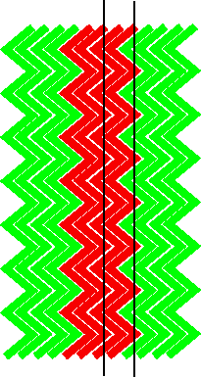
Non-homogeneous Electric Fields
Electric Field between cathode and anode plates not perfectly homogenous due to zig-zag shape of accordion structure
Affects how much Ionization of LAr medium is collected
Thus, the layer energy response of the detector is periodically modulated as a function of the phi value of particle trajectory.
r
φ

Slide 36
Input Statistics
Muons (|Pdg = 13|) generated at the center of detector with
CME of 100 Gev
0 < phi < 2𝝅 & 0.2 < |eta| < 0.25
Eta range does not cover the whole of EM layers; used for testing purposes for now
Advantages of Muons: Heavier mass means more localized energy depositions (compared to electrons or photons). This gives us better phi precision during our scan.
Disadvantage of Muons: Heavier mass means muons deposit on average only 3-4 Gev with minimal ionization. This, in-turn, increases our energy uncertainty, requiring larger size of input data.
Muon event selection: We are only interested in Muon events that mainly deposit energy through MIPs. Other forms of deposition, for example, photon-radiation contribute to uncertainty in energy deposited at a particular phi value.
Therefore, we only keep muons with high enough final energies (E > 92 Gev).

Slide 37

Final Truth Energy of Muons
Selected events
Region of large non-MIP energy deposition
E (Mev)

Slide 38

Result
E [Mev]
Result for Layer 2 of LAr EM layers. Most important for this work as it is the layer with the most phi partitions.
φ

Slide 39
Remaining Work
Improve plot with larger number of events
Implement the energy correction in the FastCaloSim code to account for accordion structure

Slide 40
Pictures:)

Slide 41



The CIS techs go to Barcelona!
When we had to evacuate the detector :)

Slide 42

The CIS techs go skiing!

Slide 43

Katie did a shift at the CALO/FWD desk in the ACR!

Slide 44



Slide 45
Thank You!

